Slide 1
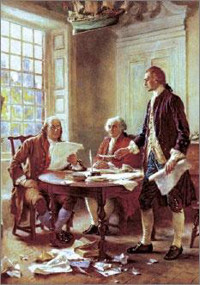
Lesson 1: What Did the Founders Think about Constitutional Government?

Slide 2
Lesson PURPOSE:
This lesson introduces the basic ideas and experiences the founding generation drew on to create the kind of government they believed would best protect natural rights and the common good.
Participation in colonial self-government and early America’s diversity fostered rich dialogue about the purpose of government and how it should be organized.

Slide 3
Lesson 1 Objectives:
Describe the diverse features of the early American colonies and their populations.
Explain what the Founders learned about government from history and their firsthand experiences of government and how this shaped their thinking.
Explain the meanings of the terms “constitution” and “constitutional government” and describe the forms of constitutional governments.
Evaluate, take, and defend positions on
the sources that should be consulted if a new constitution were written today.
whether the founders’ concerns about abuse of power are still valid.
the importance of written Constitutions.

Slide 4
Lesson 1 Terms and Concepts:
Constitution
A plan of government that sets forth the structures and powers of government. In democracies, a constitution is an authoritative law through which the sovereign people authorize a government to be established and grant it certain powers.
constitutional government
Limited government; the rule of law. A form of government in which a written, unwritten, or partly written constitution serves as a higher or fundamental law that everyone, including those in power, must obey. The rule of law is an essential feature of constitutional government.
Democracy
Literally defined as "rule of the people," democracy is a form of government in which all citizens exercise political power, either directly or through their elected representatives.
forms of government
(1) Aristotle's idea of three forms of government based on the number of people exercising power. Each has a "right" form and a "corrupt" form. The right form of government by a single person is a "monarchy." The right form of government by a few people is an "aristocracy." And the right form of government by many people is called "polity." (2) Types of democratic governments. For example, parliamentary systems, such as those of Britain and India; separation of powers systems, such as that of the United States; and presidential systems, such as that of France. (3) General forms of government, such as monarchies, republics, and autocracies.

Slide 5
Lesson 1 Terms and Concepts:
limited government
In natural rights philosophy, a system restricted to protecting natural rights that does not interfere with other aspects of life. More generally, limited government is constitutional government governed by the rule of law. Written or unwritten constitutions are used to empower and limit government.
Parliament
The British legislature, which consists of two houses: the House of Lords, which once represented the nobility, and the House of Commons, which formally represents the common people. Most members of the House of Lords are appointed for life by the government of the day and are not members of the hereditary aristocracy, who once dominated it.
republic
According to James Madison, a form of government that derives its powers directly or indirectly from the people, is administered by officials holding power for a limited time, and incorporates representative institutions.
unwritten constitution
The body of political practices developed through custom and tradition. Only three of the world's major democracies have constitutions that are not single, written documents: Britain, Israel, and New Zealand. In each of these nations, the constitution is a combination of written laws and precedents.
written constitution
A written plan of government that sets forth the structures and powers of government.

Slide 6
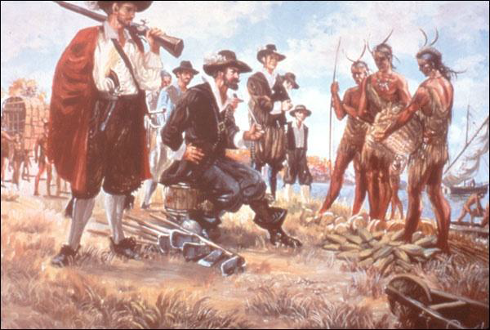
Characteristics of Colonial America
Europeans first settled two centuries before the Treaty of Paris (1783)
Native American Population on the Decline (war, disease)
Diverse European backgrounds (German, French, Dutch)
Came for religious (Puritans) and economic (Jamestown) reasons

Slide 7
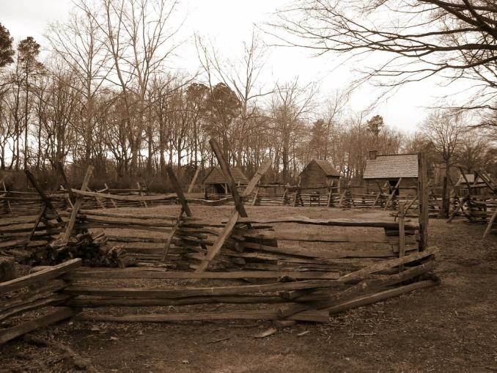
Characteristics Cont.
Vast estates in Middle to South, smaller towns in New England
Southern farms grew export crops, were larger with many more slaves
New England –subsistence farming, livestock, local markets

Slide 8
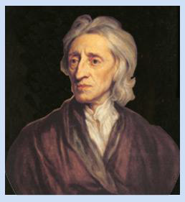
How did the FOUNDERS learn about Government?
Read classical texts about gov’t& politics (Aristotle)
Studied newer 16th& 17thc. philosophers (Locke)
Also fell back on 150 years of local self-government
Free white men served on juries, attended town meetings, and voted in local elections

Slide 9
What did the Founders Learn?
Government should be a servant, not the master, of the people
A fundamental higher law, or constitution, should limit government

Slide 10
Forms of Government
Aristotle’s forms of government
Believed they must perform three functions: Executive, Legislative, Judicial.
Rule of One= Monarchy (corrupt = Tyranny) Rule of Few= Aristocracy (corrupt = Oligarchy) Rule of Many= Polity (corrupt = Democracy)
Aristotle feared that in a direct democracy, the poor would seize the wealth of the rich through warfare
Founders favored a representative (republican) form of government

Slide 11
What is a CONSTITUTION?
Def: A plan that sets forth the structure and powers of a government
Constitutional government also means limited government
Government limited by the provisions of the constitution
Written Constitutions are controversial since it involved interpretation, change, and the power of who has the final say

Slide 12
Characterizing Higher Law
Different from legislative statute in following ways:
Sets forth basic rights of citizens
Establishes responsibility of the gov’t to protect those rights
Establishes limitations on gov’t power regarding rights, distribution of resources, and conflict management
Can be changed only with consent of the people and according to established procedures

Slide 13
Cont.
Different from legislative statute in following ways:
Sets forth basic rights of citizens
Establishes responsibility of the gov’t to protect those rights
Establishes limitations on gov’t power regarding rights, distribution of resources, and conflict management
Can be changed only with consent of the people and according to established procedures

Slide 14
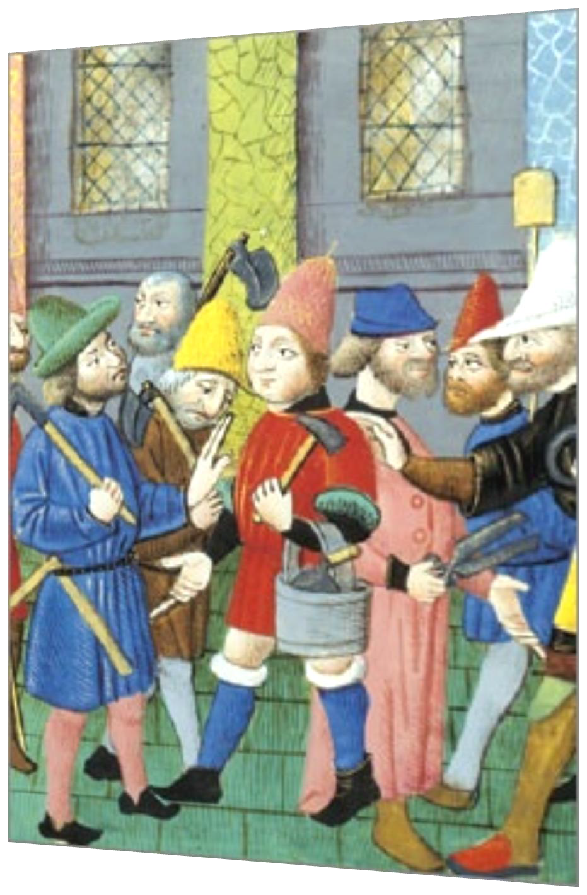
Lesson 2:
What Ideas
about Civic Life
Informed the
Founding
Generation?

Slide 15
Lesson PURPOSE
People’s judgment about government may reflect ideas about human nature, the proper function and scope of government, the rights of individuals, and other values.
Political philosophers have discussed these matters for thousands of years.
This lesson examines important concepts such as the common good, civic virtue, the state of nature, natural rights, consent, and the social contract.

Slide 16
Lesson 2 Objectives:
Describe how and why natural rights philosophy differs from classical republicanism.
Describe how both systems of thought influenced the founding generation.
Explain challenges society faces when it strives to preserve the rights to life, liberty, property, and the “pursuit of happiness,” while also promoting the common good and civic virtue.
Evaluate, take and defend positions on the importance of civic virtue today and the role of political philosophy in thinking about government.

Slide 17
Lesson 2 Terms & Concepts
civic virtue
The dedication of citizens to the common welfare of their community or country, even at the cost of their individual interests.
classical republicanism
The ideals and practices of ancient Greek or Roman city-states that emphasized civic participation and the responsibility of citizens for the well-being of their polity, or country. Acts by citizens that placed the public good, or common welfare, above private interest were especially prized.
common good
The good of the community as a whole, as contrasted with private interests that may conflict with public interest. Also known as the public good.
consent of the governed
Agreement by citizens to obey the laws and the government they create. Consent is the foundation of government's legitimacy.

Slide 18
divine right
The idea prevalent in early modern Europe that monarchs derive their authority directly from God. Adherents to this doctrine claimed that to disobey such monarchs, to attempt to replace them, or to limit their powers is contrary to the will of God. Also known as the divine right of kings.
inalienable rights
Fundamental rights inherent to being human that every person therefore possesses that cannot be taken away by government or another entity. This phrase was used in the Virginia Declaration of Rights and the Declaration of Independence.
natural rights
The doctrine that people have basic rights, such as those to life, liberty, and property in a state of nature. Some writers, especially those influencing the American Founders, argued that certain of these rights are inalienable-inherent in being human-and that people create governments to protect those rights.
political legitimacy
Acceptance by the governed that the claim to authority by those who govern is justified. In democratic societies, legitimacy is achieved only when those who govern gain power through the free consent of the governed in free and fair elections.
popular sovereignty
The natural rights concept that ultimate political authority rests with the people.

Slide 19
pursuit of happiness
An "unalienable" right stated in the Declaration of Independence. It is the right of Americans to pursue personal fulfillment in their own way, so long as they do not infringe on the rights of others. Within certain limits, this right denies the legitimacy of government to decide what kind of happiness one ought to seek.
right to revolution
The right of the sovereign people of any democratic state or regime to depose a government after it has attacked citizens' basic rights for a significant period of time. This right, espoused by English philosopher John Locke, was asserted in the Declaration of Independence to justify separation from Britain and the overturning of the authority of King George III.
social contract theory
Presumption of an imaginary or actual agreement among people to set up a government and obey its laws. The theory was developed by the English natural rights philosopher John Locke, among others, to explain the origin of legitimate government.
state of nature
The condition of people living in a situation without government; anarchy. Natural rights philosophy inquired about what rights, moral rules, or laws applied in such circumstances and what rights, if any, people retained after agreeing to leave the state of nature to form a politically organized society or state.

Slide 20
The Founding Generation’s Values
Classical Republicanism (Ancient Rome)
Place the needs of people as a community above individual liberty and self-determination (Promoting the common good)
Three Main Aspects of Classical
Republicanism
Small, uniform communities
Good gov’t is only possible in small communities because people are able to know and care for one other and discern the common good.

Slide 21
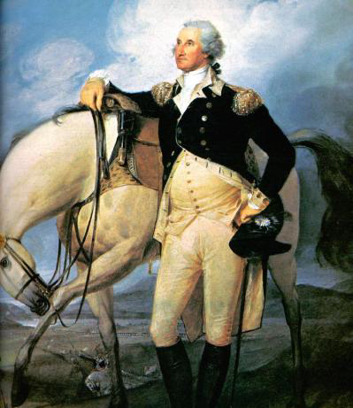
Citizenship & Civic Virtue
Citizens should set aside personal interests to promote common good. (ex. Cincinnatus / Washington)
Moral Education
Children must learn
rituals & values of society, skills to speak & reason well, Values of civic virtue, Skills to participate in political debate

Slide 22
The Role of Philosophy in the Study of Government
New philosophies challenges Divine Right of Kings in 1600s
Idea that monarchs derive their authority to rule from God
New thinkers suggested that self-government was required for social peace and a just society.
Natural Rights philosophy suggest what life would be like in a complete state of nature (no government)

Slide 23
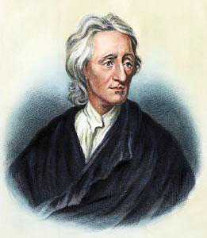
Natural Rights Philosophy
Social Contract Theory
17thc. -Thomas Hobbes proposes that people enter a contract with government to maintain stability & peace.
John Locke
People possess inalienable rights (life, liberty, property)
Government protects natural rights, but can be replaced if it fails to protect those rights

Slide 24
Natural Rights’ Influence on Founders
Individual Rights
Inalienable rights exist regardless of wealth, social status, or birth.
Popular Sovereignty
The government derives its authority from the people. (social contract)
People have the right to create whatever government they feel is best.
Limited Government
Authority is limited by the purpose for which government is created.
Human Equality
All people are free from another’s control and are equal to another.
Colonial American enjoyed more social equality than Europe, but huge social inequalities remained. (SLAVERY)

