Slide 1
Ming China

Slide 2
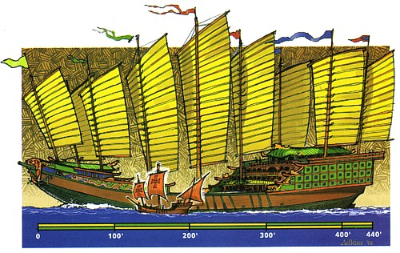
Two-minute recall
What are some of the reasons the Chinese withdrew from the missions of Zheng He?

Slide 3
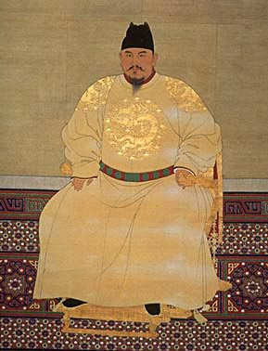
Confucian Revival under the Ming
First Ming emperor Hongwu
After defeat of Mongols, scholars got their jobs back
Expansion of examination system created large, educated elite
Imperial academies and regional colleges restored
Neo-Confucianism firmly implanted

Slide 4
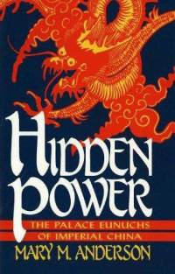
Hongwu’s Checks and balances
Hongwu eliminated chief minister position, transferred power to self
Harsh punishment for failure
Imperial wives from humble families
Number of eunuchs limited
Rivals exiled to provincial estates
Censorship
Changes eased under later rulers

Slide 5
One step forward
New, untaxed lands opened up
Forced labor demands lowered
Handicraft industries promoted

Slide 6
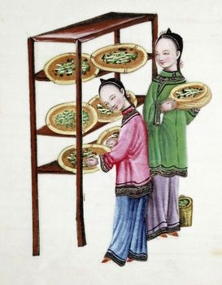
Two steps back
Rural warlords allied with bureaucracy gained power
Peasants forced to become tenants or landless laborers
Continued subordination of women to men and youth to elders
“Draconian” laws (LEGALISM)

Slide 7
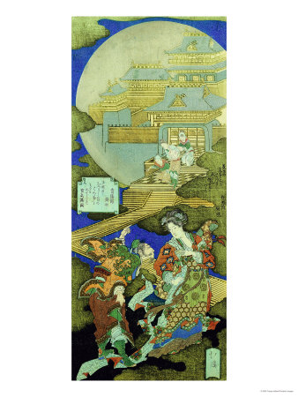
Women in Ming China
Some women worked behind the scenes in the court to influence politics
Women confined to household, status dependent on having boys
Upper class women literate, but barred from positions of power
Non-elite women could become courtesans or entertainers, one of only ways to rise

Slide 8
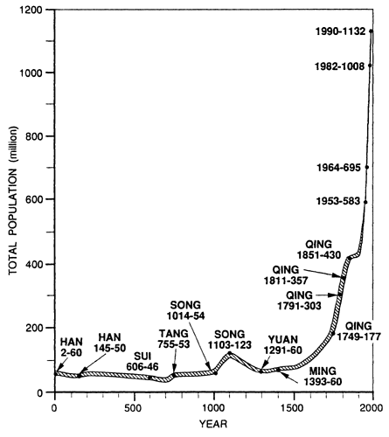
Ming Economics
Continued commercial boom of Song
American food crops opened new agricultural areas
Population at 300 million by 1800
High demand for Chinese goods
“Cantonment” system limited European influence
Growing influence of merchants, bought land

Slide 9
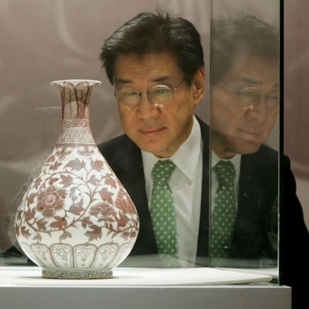
The Arts
Merchants = patrons for artists
Woodblock printing led to more books
Development of the novel
$10 Million Ming era vase

Slide 10
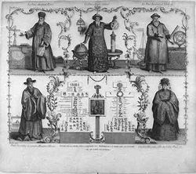
Isolationism
After Zheng He, closed off
1390 – decree limiting overseas commerce
Navy allowed to decline
Franciscans, Dominicans, Jesuits worked to convert the masses and the elite
Jesuits shared technical knowledge to win friends and influence people
Most considered Europeans barbarians

Slide 11
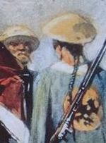
Decline
Increasing corruption & weak leadership
Failure of public works led to flooding of Yangtze
Increasing exploitation of landlords
1644 – rebels brought down govt.
Invasion by Manchu who established Qing

