Slide 1
MC DECODING PERIOD 3

Slide 2
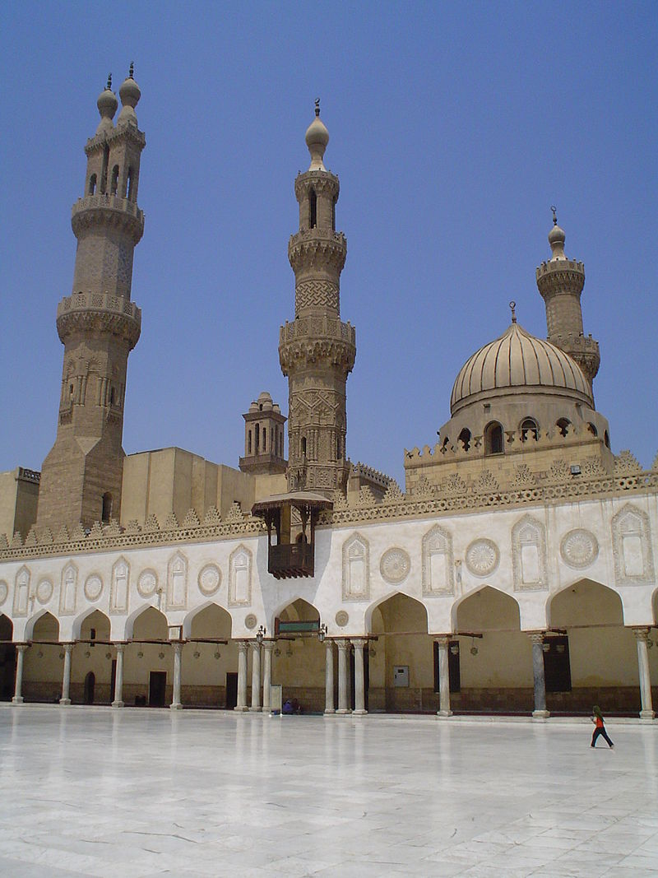
1. The image is best seen as evidence for which of the following?
A. The failure of European Crusaders to re-take the Holy Land from the Muslims
B. The impact of the spread of Islam during the seventh century
C. The mass migration of Muslims down the Swahili Coast
D. The use of architecture to glorify Islamic rulers
AL-AZHAR MOSQUE, CAIRO, EGYPT, C. 972

Slide 3
1. The image is best seen as evidence for which of the following?
A. The failure of European Crusaders to re-take the Holy Land from the Muslims
B. The impact of the spread of Islam during the seventh century
C. The mass migration of Muslims down the Swahili Coast
D. The use of architecture to glorify Islamic rulers
AL-AZHAR MOSQUE, CAIRO, EGYPT, C. 972

Slide 4
2. The architecture shown in the image would have been a result of all of the following EXCEPT
A. Islamic military expansion from Arabia through North Africa
B. existing trade networks in Afro-Eurasia
C. an increase in the number of universities in Egypt
D. missionary activity
AL-AZHAR MOSQUE, CAIRO, EGYPT, C. 972

Slide 5
2. The architecture shown in the image would have been a result of all of the following EXCEPT
A. Islamic military expansion from Arabia through North Africa
B. existing trade networks in Afro-Eurasia
C. an increase in the number of universities in Egypt
D. missionary activity
AL-AZHAR MOSQUE, CAIRO, EGYPT, C. 972

Slide 6
3. The architecture shown in the image can best be used for evidence for which of the following world historical trends that took place during the period 600 C.E. to 1450 C.E.?
A. The sponsorship of art and architecture by elites
B. Governments using religion to increase the loyalty of their population
C. The diffusion of Arabic and North African literary traditions
D. The diffusion of Arabic and North African artistic and cultural traditions
AL-AZHAR MOSQUE, CAIRO, EGYPT, C. 972

Slide 7
3. The architecture shown in the image can best be used for evidence for which of the following world historical trends that took place during the period 600 C.E. to 1450 C.E.?
A. The sponsorship of art and architecture by elites
B. Governments using religion to increase the loyalty of their population
C. The diffusion of Arabic and North African literary traditions
D. The diffusion of Arabic and North African artistic and cultural traditions
AL-AZHAR MOSQUE, CAIRO, EGYPT, C. 972

Slide 8
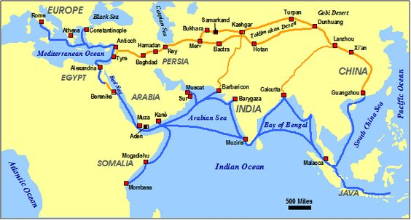
4. The map above reflects which of the following?
A. The growth of interregional trade in luxury goods
B. The growth of commercial infrastructures
C. The growth of communication networks
D. Zheng He’s voyages into Europe

Slide 9
4. The map above reflects which of the following?
A. The growth of interregional trade in luxury goods
B. The growth of commercial infrastructures
C. The growth of communication networks
D. Zheng He’s voyages into Europe

Slide 10
5. Which of the following factors contributed most to the sea routes depicted on the map?
A. The spread of Persian as the “lingua franca” or common business language in Eurasia
B. Innovations in weaponry such as the use of gunpowder for warfare
C. Maritime innovations such as the use of the compass and astrolabe
D. Exploration encouraged by the Mongol emperors in order to strengthen their empires

Slide 11
5. Which of the following factors contributed most to the sea routes depicted on the map?
A. The spread of Persian as the “lingua franca” or common business language in Eurasia
B. Innovations in weaponry such as the use of gunpowder for warfare
C. Maritime innovations such as the use of the compass and astrolabe
D. Exploration encouraged by the Mongol emperors in order to strengthen their empires

Slide 12
6. Based on the map and your knowledge of world history, which of the following best describes the effect of the land and sea routes depicted on the map?
A. The migration of Mongols into Eastern Europe
B. The growth of new trading cities
C. An expansion of caravan trade along the Silk Road
D. The creation of a more uniform system of credit

Slide 13
6. Based on the map and your knowledge of world history, which of the following best describes the effect of the land and sea routes depicted on the map?
A. The migration of Mongols into Eastern Europe
B. The growth of new trading cities
C. An expansion of caravan trade along the Silk Road
D. The creation of a more uniform system of credit

Slide 14
7. The land and sea routes depicted on the map was a result of the expansion of all of the following empires during the post-Classical period EXCEPT
A. the Mongols
B. Alexander’s Empire
C. the caliphates
D. the Byzantines

Slide 15
7. The land and sea routes depicted on the map was a result of the expansion of all of the following empires during the post-Classical period EXCEPT
A. the Mongols
B. Alexander’s Empire
C. the caliphates
D. the Byzantines

Slide 16
“The pilots of Oman pass by the channel to reach the island…which is in the Zanj Sea [region of the Indian Ocean] …I myself have sailed on this sea…in company with a number of Omani ship owners…I have sailed much on the seas…but I do not know of one more dangerous than that of the Zanj…
The land of Zanj produces wild leopard skins. The people wear them as clothes, or export them to Muslim countries. They are the largest leopard skins and the most beautiful…The also export tortoise-shell for making combs, for which ivory is likewise used…
In China the kings and military civil officers use ivory palanquins…Thus they seek after straight tusks in preference to the curved to make the things we have spoken of.”
--Abul-Hasan Ali al-Masudi, Arab trader, 943 C.E.
8. Which of the following best describes the reason for an expansion of trade throughout the Indian Ocean region during the Post-Classical period?
A. An increased demand for luxury goods
B. The spread of Christianity into East Africa
C. The diffusion of Portuguese maritime innovations by Islamic traders
D. The growth of increasingly centralized government in East Africa

Slide 17
“The pilots of Oman pass by the channel to reach the island…which is in the Zanj Sea [region of the Indian Ocean] …I myself have sailed on this sea…in company with a number of Omani ship owners…I have sailed much on the seas…but I do not know of one more dangerous than that of the Zanj…
The land of Zanj produces wild leopard skins. The people wear them as clothes, or export them to Muslim countries. They are the largest leopard skins and the most beautiful…The also export tortoise-shell for making combs, for which ivory is likewise used…
In China the kings and military civil officers use ivory palanquins…Thus they seek after straight tusks in preference to the curved to make the things we have spoken of.”
--Abul-Hasan Ali al-Masudi, Arab trader, 943 C.E.
8. Which of the following best describes the reason for an expansion of trade throughout the Indian Ocean region during the Post-Classical period?
A. An increased demand for luxury goods
B. The spread of Christianity into East Africa
C. The diffusion of Portuguese maritime innovations by Islamic traders
D. The growth of increasingly centralized government in East Africa

Slide 18
“The pilots of Oman pass by the channel to reach the island…which is in the Zanj Sea [region of the Indian Ocean] …I myself have sailed on this sea…in company with a number of Omani ship owners…I have sailed much on the seas…but I do not know of one more dangerous than that of the Zanj…
The land of Zanj produces wild leopard skins. The people wear them as clothes, or export them to Muslim countries. They are the largest leopard skins and the most beautiful…The also export tortoise-shell for making combs, for which ivory is likewise used…
In China the kings and military civil officers use ivory palanquins…Thus they seek after straight tusks in preference to the curved to make the things we have spoken of.”
--Abul-Hasan Ali al-Masudi, Arab trader, 943 C.E.
9. The ability of Muslim voyagers to successfully sail in such conditions as described in the passage reflect which of the following characteristics?
A. Their exclusive control of Indian Ocean trade routes
B. Their ability to predict Indian Ocean currents and the monsoon winds
C. Their use of better maps and compasses to help navigate the Indian Ocean currents
D. Their invention of the astrolabe to help navigate the Indian Ocean currents

Slide 19
“The pilots of Oman pass by the channel to reach the island…which is in the Zanj Sea [region of the Indian Ocean] …I myself have sailed on this sea…in company with a number of Omani ship owners…I have sailed much on the seas…but I do not know of one more dangerous than that of the Zanj…
The land of Zanj produces wild leopard skins. The people wear them as clothes, or export them to Muslim countries. They are the largest leopard skins and the most beautiful…The also export tortoise-shell for making combs, for which ivory is likewise used…
In China the kings and military civil officers use ivory palanquins…Thus they seek after straight tusks in preference to the curved to make the things we have spoken of.”
--Abul-Hasan Ali al-Masudi, Arab trader, 943 C.E.
9. The ability of Muslim voyagers to successfully sail in such conditions as described in the passage reflect which of the following characteristics?
A. Their exclusive control of Indian Ocean trade routes
B. Their ability to predict Indian Ocean currents and the monsoon winds
C. Their use of better maps and compasses to help navigate the Indian Ocean currents
D. Their invention of the astrolabe to help navigate the Indian Ocean currents

Slide 20
“The pilots of Oman pass by the channel to reach the island…which is in the Zanj Sea [region of the Indian Ocean] …I myself have sailed on this sea…in company with a number of Omani ship owners…I have sailed much on the seas…but I do not know of one more dangerous than that of the Zanj…
The land of Zanj produces wild leopard skins. The people wear them as clothes, or export them to Muslim countries. They are the largest leopard skins and the most beautiful…The also export tortoise-shell for making combs, for which ivory is likewise used…
In China the kings and military civil officers use ivory palanquins…Thus they seek after straight tusks in preference to the curved to make the things we have spoken of.”
--Abul-Hasan Ali al-Masudi, Arab trader, 943 C.E.
10. Which of the following products would Chinese merchants use for trade throughout the Indian Ocean region?
A. Textiles and porcelain
B. Textiles and tomatoes
C. Tomatoes and bananas
D. Porcelain and bananas

Slide 21
“The pilots of Oman pass by the channel to reach the island…which is in the Zanj Sea [region of the Indian Ocean] …I myself have sailed on this sea…in company with a number of Omani ship owners…I have sailed much on the seas…but I do not know of one more dangerous than that of the Zanj…
The land of Zanj produces wild leopard skins. The people wear them as clothes, or export them to Muslim countries. They are the largest leopard skins and the most beautiful…The also export tortoise-shell for making combs, for which ivory is likewise used…
In China the kings and military civil officers use ivory palanquins…Thus they seek after straight tusks in preference to the curved to make the things we have spoken of.”
--Abul-Hasan Ali al-Masudi, Arab trader, 943 C.E.
10. Which of the following products would Chinese merchants use for trade throughout the Indian Ocean region?
A. Textiles and porcelain
B. Textiles and tomatoes
C. Tomatoes and bananas
D. Porcelain and bananas

