Slide 1
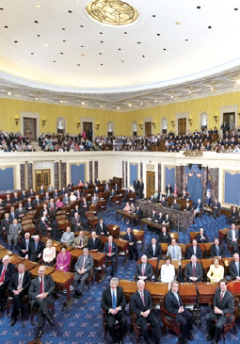
Lesson 21:
What Is the Role of Congress in American Constitutional Democracy?

Slide 2
Purpose
Congress is often called America’s first branch because of its lawmaking powers and control over the nation’s purse.
Congress is also considered the “People’s Branch” since it is directly accountable to the electorate.
This lesson examines Congress’s constitutional powers and how it represents both the people and the states.

Slide 3
Objectives
Explain basic differences between Congress and the British Parliament and how Congress reflects America’s commitment to representative government and federalism.
Identify several constitutional sources of power and some of the challenges members face in representing and serving constituents.
Evaluate, take and defend positions on contemporary issues about congressional representation and organization.

Slide 4
Terms to Know
delegate theory The idea that a legislative representative should exactly mirror his or her constituents' views in deciding on public policy. enforcement powers The power of Congress to enforce laws. enumerated powers Those rights and responsibilities of the U.S. government specifically provided for and listed in the Constitution. federalism A form of government in which power is divided and shared between a central government and state and local governments.

Slide 5
Terms to Know
gerrymandering Drawing the boundaries of an electoral district to favor a political party. implied powers Those powers authorized by a legal document that are not expressly stated but can be inferred from expressly stated powers. The power of Congress to do all things "necessary and proper" to carry out the powers delegated to it by Article I, Section 8, Clause 18 of the U.S. Constitution. The "necessary and proper" clause is also known as the "elastic clause," because it greatly expands the Constitution's enumeration of the powers of Congress. Implied powers can be distinguished from "inherent powers," those that are expressly provided for in the Constitution. inherent powers Those powers ingrained so deeply in an institution that they need not be stated. For example, what the "inherent powers of the presidency" might be is a hotly contested subject in American national politics. trustee theory of representation The idea that a legislative representative should use his or her best judgment in making decisions on public policy, regardless of constituent opinion.

Slide 6
Differences Between Congress and the British Parliament
Although British Parliament served as a model for our 2-house legislature, there are 4 major differences.
1) Representation
British Parliament
Designed to represent specific order in society.
House of Lords - traditionally an inherited seat. Today hold honorary lifetime appointments. (1200 members)
House of Commons – elected, represent geographic regions
Congress
House of Reps – represent viewpoints of district / frequent turnover (2 yr. terms)
Senate – represent whole state / longer terms ( 6 yrs.)

Slide 7
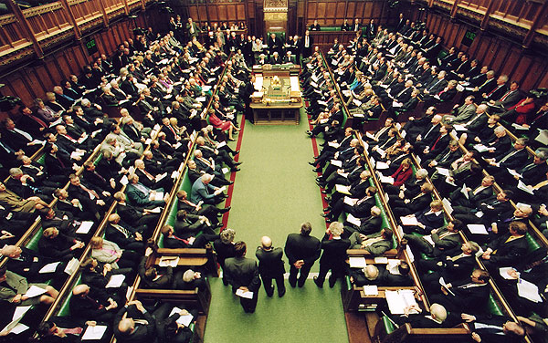
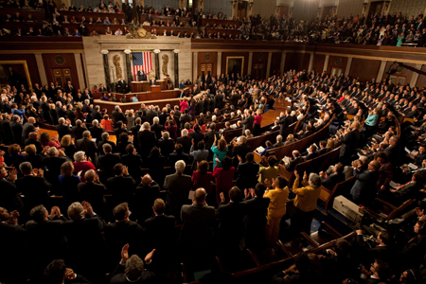
Differences Between Congress and the British Parliament
2) Separation of Powers
British Parliament
Leader of majority party appoints prime minister (chief executive and chief legislator)
Members of Parliament hold Cabinet positions as well
House of Commons is much more powerful house
http://www.youtube.com/watch?v=TsAa9VmwOaI
Congress
Article 1 Sec 6 prohibits mingling of executive and legislative powers
House & Senate both powerful, frequently limit each others’ power

Slide 8
Differences Between Congress and the British Parliament
3) Term Lengths
British Parliament
No fixed election schedule, but at least every 5 yrs. depending on “confidence” in prime minister and party in power
Congress
Reps (2 yr terms) / Senate (6 yrs., staggered)
4) Federalism
British Parliament
Local governments are primarily administrative units of central government. Most powers simply delegated from national level.
Congress
State legislatures wield considerable power, leading to dynamic system of federalism.

Slide 9
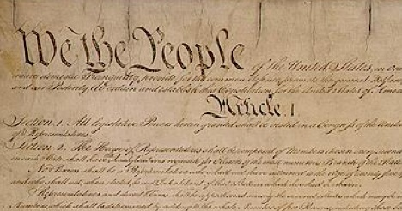
Congress’s Constitutional Powers
Limitations
Art. 1 Sec. 8 - limits powers to those “herein granted” /
18th power = “all laws… necessary and proper for carrying into execution the foregoing powers”
Art. 1 Sec. 9 – lists matters congress “shall not” legislate
Tax state exports, grant titles of nobility…
Bill of Rights – list of rights Congress “shall not” infringe
First – “Congress shall make no law” abridging free press

Slide 10
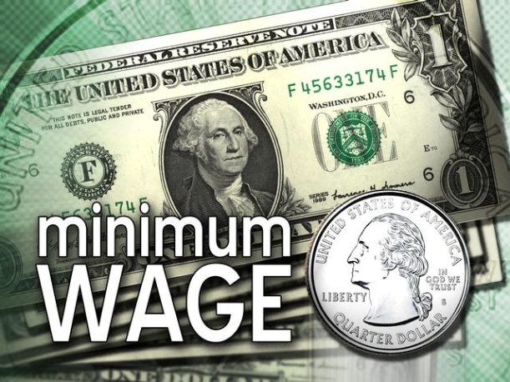
Congress’s Constitutional Powers
Enumerate Powers
Those powers listed in Constitution
Ex) “Regulate Commerce”
Congress now regulates manufacturing,
child labor, wages…
Implied Powers
Some expressed powers imply additional powers
Ex) “Necessary and Proper” Clause
Court Case: McCulloch v. Maryland (1819)
Decision = N & P clause and power to coin & borrow money implied power to create a national bank.
Congressional Oversight
Implied power to create, and monitor, executive agencies designed to implement policy mandates.

Slide 11
Representing the People & The States
No constitutional term limits
Since 1842, all members of House elected from single-member districts
Many states redistrict after each 10-yr. census
Drawn by state legislatures or independent commissions
Dissatisfied groups can challenge redistricting in court

Slide 12
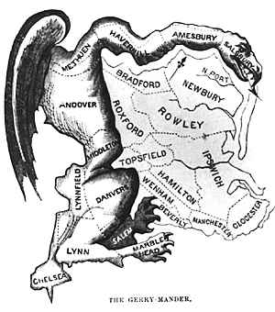
Controversy Over Districting
Court Case: Wesberry v. Sanders (1964)
Decision – adopted rule of “one person = one vote”
New requirements have not ended debate over Gerrymandering
Senate initially chosen by state legislatures, but 17th Amendment creates direct elections

Slide 13
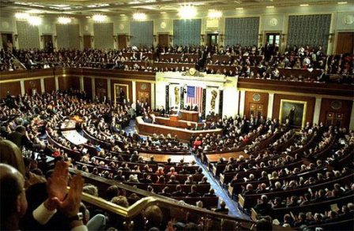
Controversy Over Districting
1913 – Congress fixes size of House at 435
By 2004, average House district population over 700,000
Surpassed worldwide only by India
District size creates challenges addressing needs and interests of such diverse constituencies

Slide 14
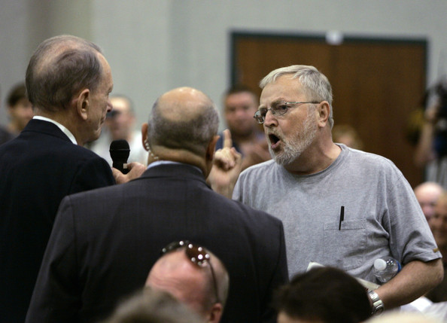
Theories of Representation
Delegate Theory or Trustee Theory?
Most representatives claim to practice both
Our vast and diverse nation make it challenging to both represent constituents while also finding common ground with legislators from other regions.
Congressman Specter dealing with “unhappy” constituent
http://www.youtube.com/watch?v=jV1jmvMHsS0

Slide 15
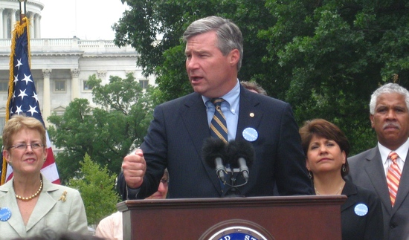
Serving Constituents
Communications
Media appearances, websites,
town hall meetings…
Case Work
Staffers help constituents solve problems involving national government.
Ex) Dealing with agencies (IRS, Social Security), asking for favors (tours, meetings w/ legislators)
Serving Constituents’ Interests and Concerns
Introducing / sponsoring legislation that serves constituents interests.
Working to have federal projects located in district (highways)

Slide 16
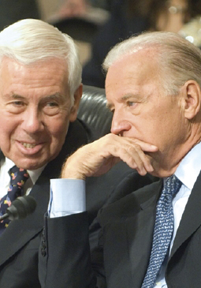
Lesson 22:
How Does Congress Perform Its Functions in the American Constitutional System?

Slide 17
Purpose
Congress is one of few national assemblies with the power to initiate legislation, not simply vote on executive’s proposals.
Congress also conducts investigations that lead to important changes in policy and removal of officials.
Despite its rules and leadership structures, the 535 member Congress faces challenges representing their growing and diverse constituencies.

Slide 18
Objectives
Describe the role of rules, committees, and political parties in Congress.
Describe the lawmaking process.
Identify the primary sources members rely upon.
Explain the importance of Congress’ power to investigate.
Explain why compromise is required in the deliberative process.
Evaluate, take, and defend positions on how Congress functions and whether it should streamline its procedures.

Slide 19
Terms to Know
bill A proposed law placed before a legislature for approval. cloture A rule of the U.S. Senate stipulating that debate on a legislative proposal be cut off and the proposal voted upon by the full Senate if sixty members agree. filibuster The practice of refusing to surrender the floor during a debate to prevent the Senate from voting on a proposal. impeachment Charging a public official with a crime while in office and bringing him or her to trial. Convicted officials are removed from office. lobbying The practice of attempting to affect legislation by influencing legislators.

Slide 20
Terms to Know
pocket veto A presidential practice that allows a bill to die if not signed within ten days and Congress is adjourned. The president is conceived as keeping the bill in his pocket rather than taking it out and signing it. power to investigate The power of Congress to undertake formal inquiries into matters of public business and public policy. resolution A formal statement of a decision or expression of opinion put before or adopted by an assembly such as the U.S. Congress. seniority Length of service. In the U.S. House of Representatives or the U.S. Senate, certain powers and responsibilities of congressional members, such as committee chairmanships, are granted on the basis of their time in office.

Slide 21
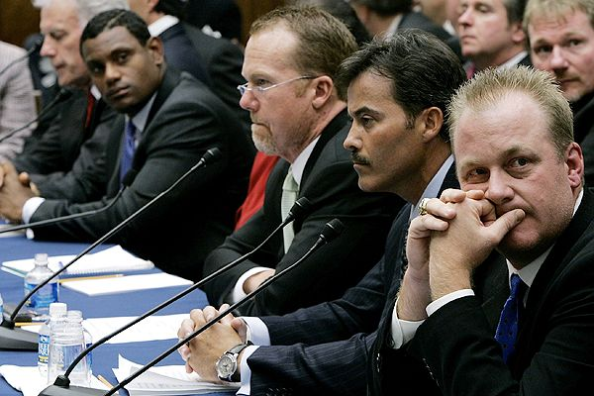
The Role of Rules & Committees
Rules and Committees not specified in Constitution, but instead created by each chamber (Art. 1 Sec. 5)
Committees
Standing (permanent) Committees have jurisdiction over particular subjects, appoint more specific subcommittees
Ex) http://www.govtrack.us/congress/committee.xpd
Hold hearings to hear public
testimony or conduct gov’t oversight
Select Committees (task forces)
exist for limit time for specific
purpose

Slide 22
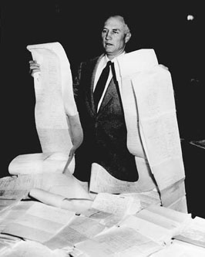
The Role of Rules & Committees
Rules
Examples
House rules specify size and jurisdiction of committees / govern form and structure of debate
Senate more informal, filibuster option remains open at all times.
However, 60 votes (cloture) brings proposal to a vote
Party Organization
Leaders encourage members to adhere to party platform
Committee chairs appointed by seniority and party loyalty

Slide 23
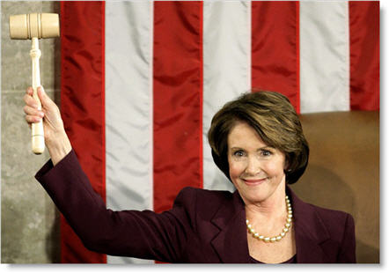
Congressional Leadership
House Leadership (3 models)
Strong Institutional Speaker
Speakers wield considerable power over organization and legislative agenda
Powers: controls committee appointments, chairs Rules Committee, “traffic cop” deciding which bills come to the floor and rules of debate.
Decentralized Committee Leadership
Some historical periods witnessed committee chairs rebelling against speaker
Party Control
Strong speaker who represents majority party
Committee chairs appointed based upon
party loyalty

Slide 24
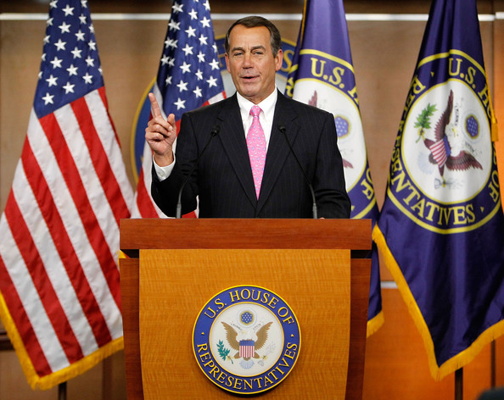
Congressional Leadership
Senate Leadership
VP is president of Senate, but only power is to cast tie-breaking vote.
Majority and Minority Leaders chosen by each party to guide operations.

Slide 25
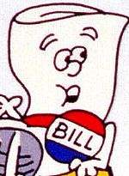
Majority Rule and Compromise in Congressional Deliberation
Bill vs. Resolution
Simple resolutions address rules or express sentiments of Congress
Joint Resolutions device for proposing Amendments or other matters. If signed (or over-ride), has force of law
Most proposals take form of a bill
Bills introduced in either House (except revenue bills= H)
Numbers with prefix S or H
The process is as follows…

Slide 26
Majority Rule and Compromise in Congressional Deliberation
Committee Assignments
Bills assigned to at least 1 committee / usually referred to subcommittees for rigorous scrutiny and amendments
Hearings
Representatives of government agencies, interest groups or outside experts present testimony
Deliberations
At “Mark Up” sessions, members can review, modify, approve final version, and recommend to full House or Senate
Report
If bill wins favorable committee vote, reported to full chamber
Committee report justifies its actions

Slide 27
Majority Rule and Compromise in Congressional Deliberation
Floor Vote
Places on calendar for consideration and a vote
Referral to the Other Chamber
If passed, sent to other chamber where process begins again
Conference Committee
When versions of bill differ (most do), conference committee (members of both house) try to reach compromise.
If agreement reached, conference report submitted for vote (cannot be amended, can be filibustered)
Referral to President
If president signs, becomes law
If vetoed, 2/3 vote needed in each chamber to over-ride
If not signed, but Congress adjourns within 10 days, bill is dead
(pocket veto)

Slide 28
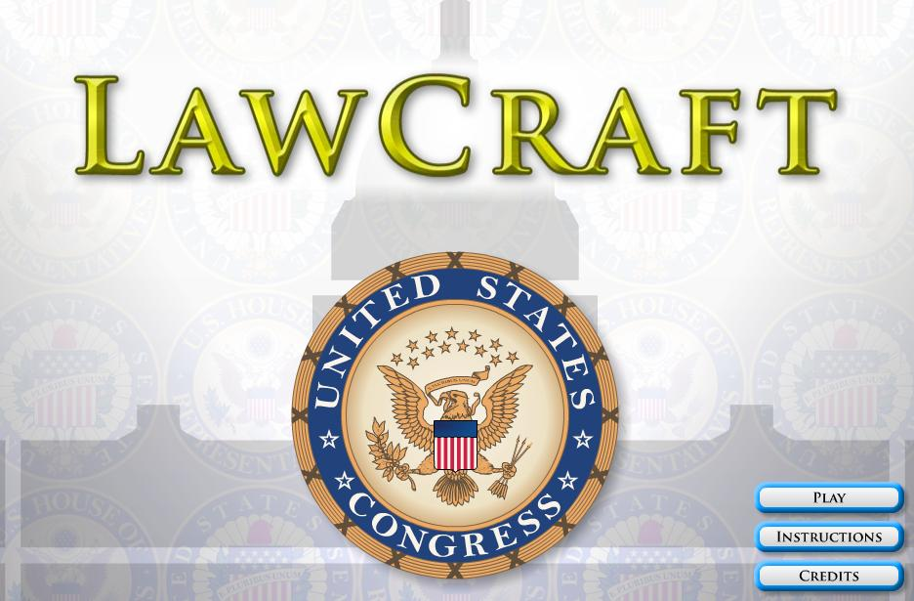
Majority Rule and Compromise in Congressional Deliberation
Bill must win majority support at each phase
Sponsors of bill must be persistent and willing to compromise
Lawmaking process demonstrates American system of representative gov’t, limited gov’t and checks and balances at work.
LawCraft
http://icivics.org/games/lawcraft

Slide 29
Ideas for Legislation & Deciding Which Bills to Support
Campaign Promises
Responses to Crisis
Legislation Introduced by Others
Library of Congress and Congressional Budget Office provide research, analysis, and projected costs.
Executive Branch
President outlines legislative agenda at State of the Union
Party members sponsor president’s legislation
Legislation also introduces by Executive departments / agencies

Slide 30
Ideas for Legislation & Deciding Which Bills to Support
Constituents
Constituents recommend enactment or repeal of laws through various forms of communication (letters, opinion polls, blogs)
Interest Groups
Organizations, industries, and interest groups employ lobbyists to help influence legislation
Reflects right to free speech, assembly, and petition
Effective Lobbyists are well-informed on issue, knowledgeable of process, well-organized, and cooperative.

Slide 31
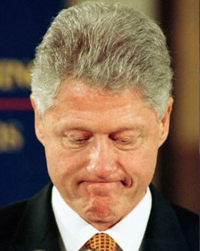
The Power to Investigate
Purpose
Finding facts on which to base legislation
Discover or influence public opinion
Oversee administrative agencies
Probe activities of public officials
Secure partisan political gain
Power to investigate also used to impeach federal officials
Initiated in House. If vote on impeachement, sent to Senate
Conviction in Senate requires 2/3 majority

