Slide 1
REVOLUTIONS

Slide 2
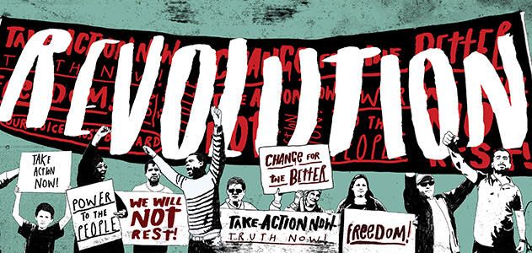
REVOLUTIONS AND REACTIONS
Revolutions and Reactions
Urbanization due to Industrialization and the new middle class led to move for individual and natural rights
Revolutions – English, American, French, Russian
Citizens dissatisfied with government
Moderate gain more power
Radicals take over in a “terror phase” (except American)
Process ends in period of calm and acceptance also known as “Thermidorean Reaction”

Slide 3
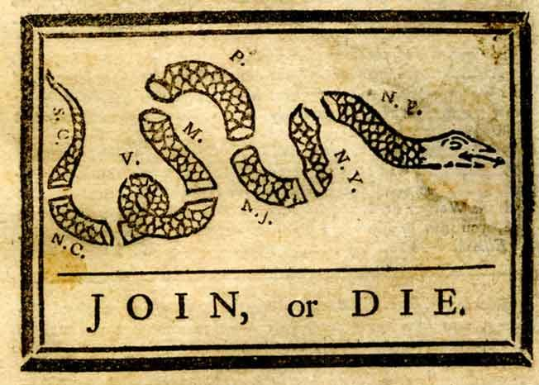
THE AMERICAN REVOLUTION
Brought about by Enlightenment ideas
No taxation without representation
Colonies already making own decisions
Distance lessened king’s power
Declaration of Independence, July 4, 1776
Treaty of Paris, 1783 US free from Great Britain
Weak Articles of Confederation replaced by US Constitution in 1788
** Main difference for America is they were already pretty autocratic. Other revolutions were under direct rule.

Slide 4
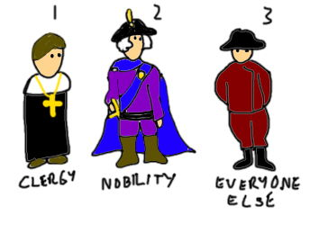
THE FRENCH REVOLUTION
Revolutionary ideas – liberte’, egalite’, et fraternite’
ECONOMIC
The estates were unfairly taxed (see diagram)
Spent too much money on wars. (Helped American Revolution)
Louis XVI spending spree
When the Estates General met to discuss increased taxes – 3rd Estate was locked out
Met for the Tennis Court Oath – Called for a limit to the King’s power
Storming of Bastille July 14th, 1789
ESTATE | POPULATION | LAND OWNERSHIP | TAXATION
First: Clergy | < 1% | @ 10% | <1%
Second: Nobility | < 2% | @ 25% | <1%
Third: Commoners | > 97% | @ 65% | >98%

Slide 5
FRENCH REVOLUTION

Slide 6
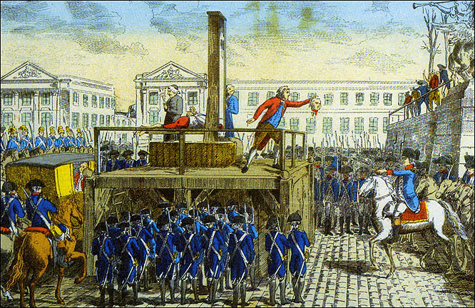
FRENCH REVOLUTION
The King agreed to the new government only to later oppose a limited monarchy.
This led to the uprising of the Jacobins – Maxmilien Robespierre
First behedaing by guillotine - Louis XVI and his wife.
Committee of Public Safety –
Return to moderates, Robespierre executed, Directory established, which abolished slavery, reformed education, ended right of primogeniture (all land left the eldest male heir.

Slide 7
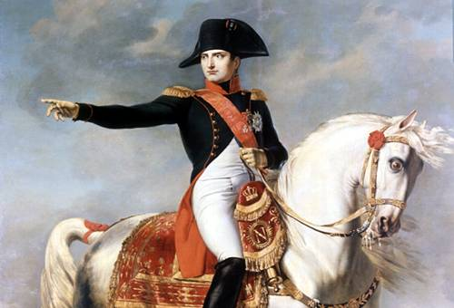
NAPOLEON BONAPARTE
1804, one man coup, Napoleon Bonaparte
Spread burden of taxation
Napoleonic Code, all citizens equal, trial by jury, freedom of religion
Public school system
Supported archeological digs in Egypt
French Legion of Honor for successful soldiers
made up with the Pope
Expansionism – gained territory and helped end Austro-Hungarian empire.
Failed to conquer Russia, Spain, Portugal, England
Congress of Vienna, Napoleon ousted

Slide 8
THE HAITIAN REVOLUTION

Slide 9
COMPARING THE HAITIAN AND FRENCH REVOLUTIONS
Haitian –
Abolished slavery Never economically successful
Both were based on Enlightenment ideas
French –
Abolished feudalism
Recovered financially

Slide 10
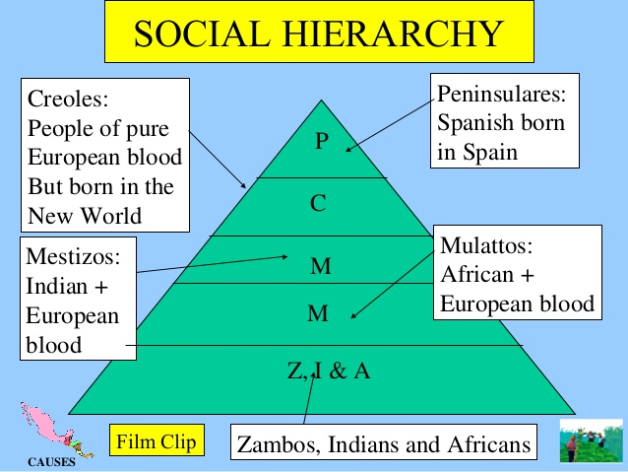
Why later than North America?
Spanish colonies governed in more authoritarian fashion
More sharply divided by class (see picture to right)
Whites vastly outnumbered
Creoles offended/insulted by Spanish monarch
Enlightenment inspires Creoles and when Napoleon invades Spain, sparks Latin Am. Revs

Slide 11
CREOLE REVOLUTIONS IN LATIN AMERICA
Peninsulares
(Spain and Portugal born)
Creole Revolutions in Latin America
Creoles wanted independence from Spain in order to trade with European countries besides Spain
Creoles
(born of European parents in the Americas)
Mestizos
(born of European and Indian parents)

Slide 12
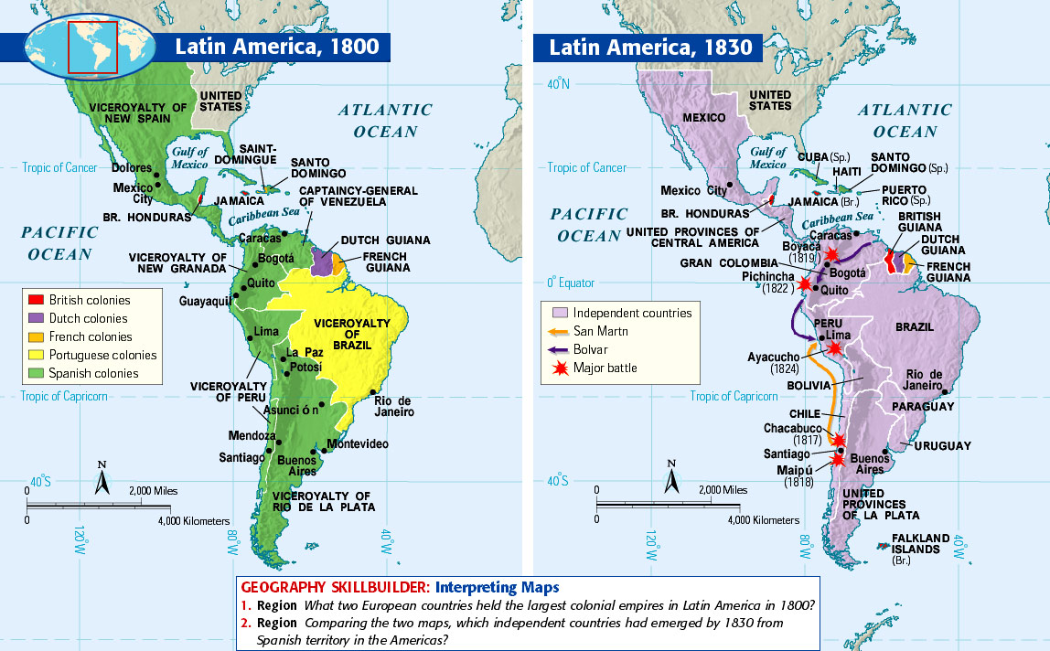
Creoles
Want independence from colonial powers
Didn’t like mercantilist policies (only trade w/ mother country)
Colonial powers gave jobs to Peninsulares – Creoles want more political power

Slide 13
Mexico
Mexican village priest, Father Miguel Hidalgo called Mexicans to fight for independence - 1810
Army of poor Mestizos and Native Americans
Wanted to end slavery and reforms to improve conditions for Native Americans
Hidalgo captured by Spanish gov’t and executed, army scatters - 1811
Father Jose Morelos continued the fight but was also captured and executed - 1815
Notes:
Crash Course 5:30-7:25 https://www.youtube.com/watch?v=ZBw35Ze3bg8&list=PLBDA2E52FB1EF80C9&index=31

Slide 14
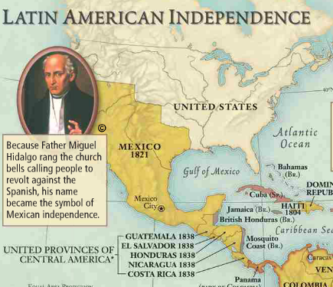
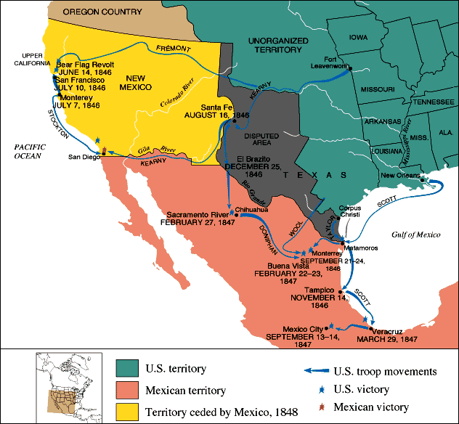
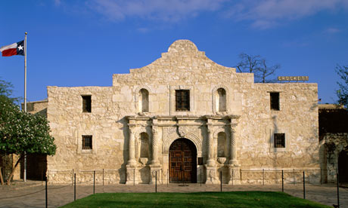
Mexico continued
Mexico independent in 1821, Republic in 1824 w/ constitution
Didn’t address unequal land distribution, poverty, status of Mexican Indians, unequal education
Liberals vs. conservatives - unstable
Separate republics of Guatemala, Nicaragua, Honduras, El Salvador, Costa Rica form
Side note: Remember the Alamo
1836 battle between US and Mexico
US Sam Houston then defeats Mexican Santa Anna’s forces and Mexico grants Texas independence and it applies for statehood
1846-1868 Mexican-American War: Mexico loses and gives territories from Texas to Cali to US for $15 million

Slide 15
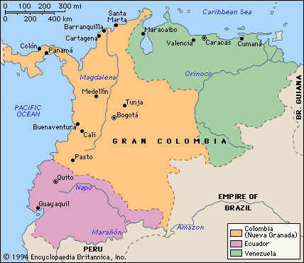
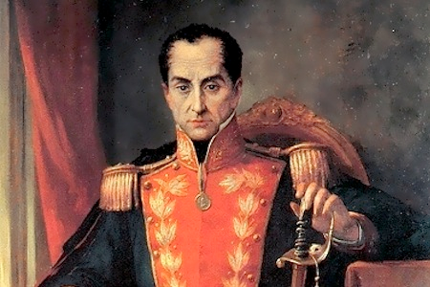
South America
Creoles discontent refuse support of mestizos, etc. and want independence from Spain
Simon Bolivar, “The Liberator”, took advantage of Napoleon’s occupation of Spain and wins independence for Venezuela
Believed in free market and abolition of slavery
Forms large area called Gran Colombia (see map right)
Goals/concerns outlined in “The Jamaica Letter”
Creoles no political or religious positions, trade restrictions (mercantilism), no factories (economic hindrance)
Largely leaves out lower classes
Joined forces with Jose de San Martin (liberator of Argentina and Chile) and gains independence for Ecuador, Peru and Bolivia
New nations of Latin America suffers from long wars of independence – unrest in many areas
Notes:
7:58-9:14 Crash Course https://www.youtube.com/watch?v=ZBw35Ze3bg8&list=PLBDA2E52FB1EF80C9&index=31

Slide 16
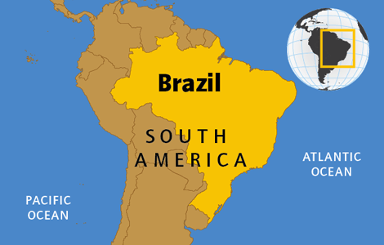
Brazil
One of most nonviolent battles for independence
Napoleon conquers Portugal
Portuguese royals flee to Brazil in 1807
1821 King has to go back to Portugal
Leaves son, Prince Dom Pedro, becomes emperor of Brazil
Dom Pedro sides with Brazilians, declares independence for Brazil
Forms constitutional monarchy
Brazil becomes republic 1889
Notes:
3:45-5:29 Crash Course https://www.youtube.com/watch?v=ZBw35Ze3bg8&list=PLBDA2E52FB1EF80C9&index=31

Slide 17
Result of Creole Revolutions
While people of color were promised freedom, end of legal restrictions, and social advancement (ideas of the Enlightenment), few promises kept once rid of Spanish rule
Creoles continued to form powerful and conservative upper class
Women gained little
Unable to vote, enter contracts, little education, submissive to men
Exception – Manuela Saenz, lover of Simon Bolivar – rose to rank of colonel

Slide 18
Differences in Latin America and North America
What do you know about difference in these two areas today?
US grows increasingly wealthy, industrialized, democratic, internationally influential, and generally stable
Latin America becomes relatively underdeveloped, impoverished, undemocratic, politically unstable and dependent on foreign technology and investment
Both areas of revolutions began in similar circumstances, but resulted in much different societies

Slide 19
Differences in American Revolutions vs European Revolutions
How are these revolutions in the Americas different from those in Europe at this time?
European revs trying to gain freedoms from OWN governments, while American revs trying to gain freedoms from FOREIGN governments

