Slide 1
How to Breakdown a Document
HIPP

Slide 2
H = Historical Content/Context
What is the point of the document?
Summary of the document
What is the region that the document is from?
What is the time period of the document?
What else is going on in this time period/region?

Slide 3
I = Intended Audience/Authorship/Format
Who wrote it?
What is the author’s position in society?
What are the limitations of the author?
Who was the source originally written for and why?
What type of source is it?
What’s the point of writing this source?

Slide 4
P = Purpose
Why did the writer create this document?
Why has this document survived?
What is the author trying to accomplish by writing this source?

Slide 5
P = Point of View
What is the author’s point of view?
What other or prior beliefs can you infer about this writer?
What might limit the knowledge of the author?

Slide 6
And Lastly…. Limitations
What does the document not tell you? What is missing/what else do you need?
What might limit the knowledge of the author?
What other sources might better help you answer the question?
What other documents might give a different point of view than the current authors perspective?

Slide 7
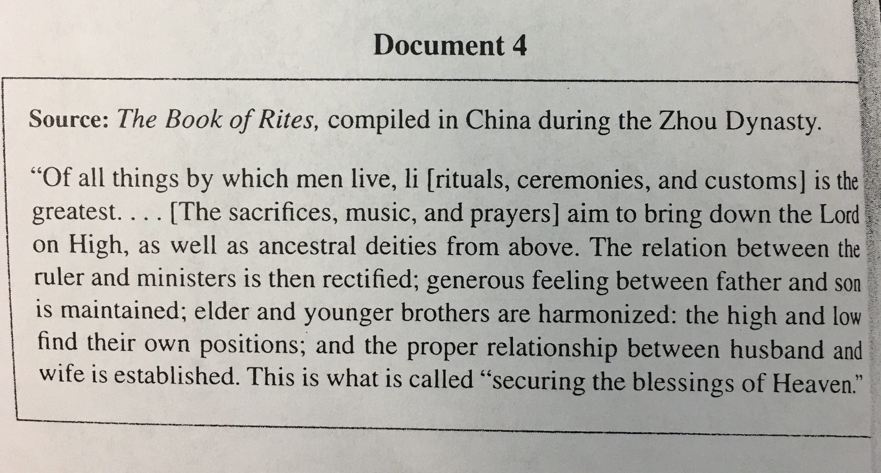
Lets Practice
Point of View/Limitations:
Purpose
Historical Content/Context
Intended Audience/Authorship/Format

