Slide 1
HARKNESS DISCUSSION

Slide 2
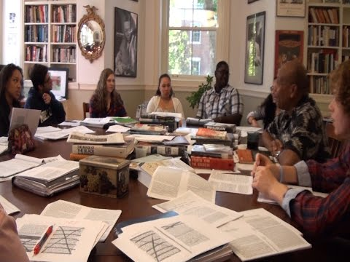
What is Harkness?

Slide 3
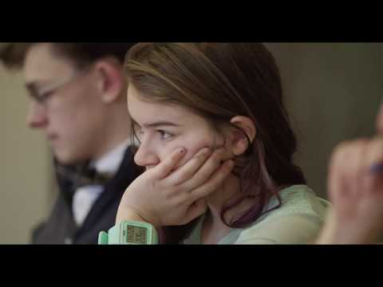

Slide 4
Harkness Discussion
Students lead and facilitate the discussion
Collaborative effort to deepen our understanding of the subject
Equal exchange of ideas
Multiple perspectives are heard
Disagreements are welcome, but it’s not a debate
It’s not a competition— it’s teamwork!
Teacher acts as a lifeguard

Slide 5
Norms
Students decide on norms
Direct comments and questions to peers
It’s ok to have silent moments
Be respectful in your disagreements
Be polite and affirming, encourage the shy to share
Do not dominate/ overtake the conversation
Help facilitate (e.g., clarify, ask each other if it’s ok to move on to the next point, refocus if the group goes on a tangent, etc.)
Teacher gives “reality checks” after 15-20 min.
Towards the last 5 min. give priority to those that haven’t shared

Slide 6
TEAM WORK
Work with your classmates toward an understanding of the literature.
The class will get one grade
However, students who do not participate will get marked down.
Students who give insightful, substantive contributions without dominating the conversation will get marked up.

Slide 7
EVALUATION
Class Grade
A= 95
B=85
C=75
D=65
*The overall class performance will be the basis of the grade you earn. Depending on your individual contribution, you may be marked up or down.

Slide 8
RUBRIC
A discussion for which everyone would receive an “A” would look like this:
Everyone participates, and more or less equally.
The pace allows for clarity and thoughtfulness, but it’s not boring.
There is a sense of balance and order: focus in on one speaker and one idea at a time.
There is an attempt to resolve questions and issues before moving on to new ones.
There is a clear sense of what the group has covered and how.
The loud do not dominate; the shy are encouraged. Everyone is clearly understood.
Students are animated, sincere, helpful.
The conversation is lively.
When the process is not working, the group adjusts. Those unhappy with the process say so.
Students take risks and dig for new meanings.
Students back up what they say with examples, quotations, etc.
All students come well-prepared.
The text, if there is one, is referred to often.
The class will earn a “B” by doing most of the things on this list, a “C” by doing only half of what’s on the list (half the class is cruising), and a “D” by doing less than half (Everyone is cruising.)

Slide 9
LEVELS OF QUESTIONING
Level 1: INPUT—Facts, information is known or can be found directly in the text
Ex: ● What time did Cinderella need to return?
● What did the fairy godmother use to transform into Cinderella’s coach?
Level 2: PROCESS—Thinking about the information
Ex: ● How would you compare Cinderella to her step sisters?
● Explain the patterns that you notice within the story.
● Why does Cinderella act with kindness despite the cruelty of her stepmother?
Level 3: OUTPUT—Applying information to new ideas and making evaluations
Ex: ● How would the stepsisters react after Cinderella left with the Prince?
● How does Cinderella’s character and story fit other archetypes? How is she different or similar to other fairytale heroines.
● How would you evaluate the effectiveness of the fairy godmother’s choice in the items she transformed? If you were to rewrite the story, what items might hold more symbolic or archetypal significance?

Slide 10
Harkness Discussion Self-check:
+Are you prepared?
+Did your comments/ questions help build the conversation?
+Did you help facilitate?
+Were you affirming?
-Were you rude?
-Were you distracted?
-Did you dominate?
-Did you speak at all?

Slide 11
DEBRIEF

Slide 12
RUBRIC
A discussion for which everyone would receive an “A” would look like this:
Everyone participates, and more or less equally.
The pace allows for clarity and thoughtfulness, but it’s not boring.
There is a sense of balance and order: focus in on one speaker and one idea at a time.
There is an attempt to resolve questions and issues before moving on to new ones.
There is a clear sense of what the group has covered and how.
The loud do not dominate; the shy are encouraged. Everyone is clearly understood.
Students are animated, sincere, helpful.
The conversation is lively.
When the process is not working, the group adjusts. Those unhappy with the process say so.
Students take risks and dig for new meanings.
Students back up what they say with examples, quotations, etc.
All students come well-prepared.
The text, if there is one, is referred to often.
The class will earn a “B” by doing most of the things on this list, a “C” by doing only half of what’s on the list (half the class is cruising), and a “D” by doing less than half (Everyone is cruising.)

Slide 13
Discussion Debrief
Based on the rubric, how do you think the class performed on our first discussion? Justify.
What were some positives?
What were some challenges?
What do you think might improve the process for next time?

