Slide 1
Disease and Medicine
1.) Medical technology is a key reason why humans are living longer in the modern era. Pick up the paper at the cart. Read and annotate it.
AP World History

Slide 2
Objectives
(6.1.III.A) Diseases associated with poverty persisted (malaria, tuberculosis, cholera), while other diseases emerged as new epidemics (1918 Flu, Ebola, HIV/AIDS) and threats to human survival. In addition, increased longevity led to higher incidence of certain diseases (diabetes, heart disease, Alzheimer’s disease).
(6.1.I.C) Medical innovations, such as vaccines and antibiotics, increased the ability of humans to survive and live longer.

Slide 3
Disease Throughout Human History
Let’s look at how disease impacts human history throughout our course.
https://ed.ted.com/on/b6v8CZfb (7:59)
Fill out the CCOT chart as you watch the video.
What are some key continuities that you notice about disease throughout history?
What are some key changes that you notice about disease throughout history?

Slide 4
Spanish Flu Case Studies
The Spanish Flu represents the first time that the government actively gets involved.
Read through your case study. Annotate for the following questions:
When did flu first appear in this community?
What were the key actions that the local government took? Why did they take these actions (think historical context)?
How successful were these at stopping the spread of flu?
What were the total deaths?
What were the changes that happened in response to the flu?

Slide 5
Group Time!
Form into groups of 4 – 5 so that each person has a different case study.
What were some of the things that governments tried to stop the spread of flu?
Successful?
Unsuccessful?
Why did governments act the way they did (historical context)?
What do you think will change as a result of this widespread pandemic?

Slide 6
What helps us curb disease?
Smallpox is a good example of a disease that we’ve largely been able to eradicate.
How have we been able to do this?
https://ed.ted.com/lessons/learning-from-smallpox-how-to-eradicate-a-disease-julie-garon-and-walter-a-orenstein (5:45)

Slide 7
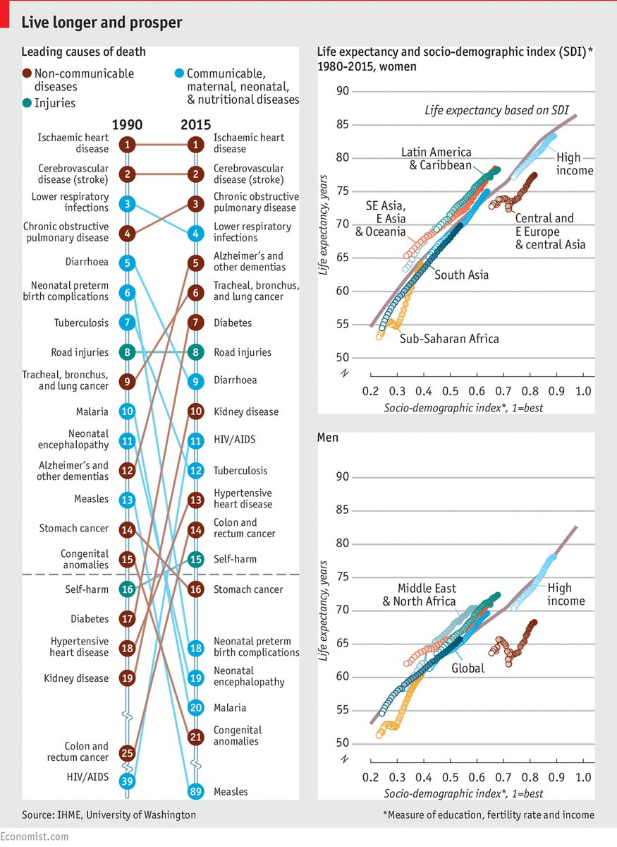
What problems persist?
People living longer doesn’t necessarily mean that everyone is healthier.
What are some key trends that you notice?

