Slide 1
Different Forms of Gov’t Foldable ACTIVITY
Items you’ll need
1. 1 sheet of white computer paper
2. Colored pencils or markers
3. Textbook or notes

Slide 2
Paper layout
Flip your paper over
Fold your paper so that you get 8 → rectangles/boxes
1 “hotdog” fold
2 “hamburger” folds

Slide 3
Direct Democracy | Indirect Democracy
Dictatorship | Unitary Government
Federal Government | Confederate Government
Presidential | Parliamentary
At the top of each box, write the following…
(1) Direct Democracy
(2) Indirect Democracy
(3) Dictatorship
(4) Unitary Government
(5) Federal Government
(6) Confederate Government
(7) Presidential
(8) Parliamentary

Slide 4
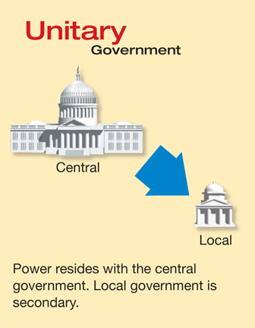
Under each Label of Gov’t please…...
Create a visual that represents either: (see color on last slide)
Red: Who can participate in the government
Blue: The power distribution within the Gov’t
Black: Relationship between the Executive and Legislative Branch.
You must use color
Example →

Slide 5
Flip your paper over…
Create a preamble for your own life.
Think about your own personal vision and the written word. You are going to create a preamble for your own life that sets into motion a basic framework upon which your life can unfold according to your needs and requirements for peace, purpose and progress.

