Slide 1
Classical Religions

Slide 2
Development and Codification of Religious and Cultural Traditions

Slide 3
Periodization
600 B.C.E to 600 C.E.
What marks the beginning?
Rise of Greek civilization and Persian Empire
Beginnings of Confucianism, Buddhism, Daoism in China (Zhou, Qin, Han dynasties)
What marks the end?
Fall of all major classical empires; “Dark” Ages
Rise of Islamic civilization (610 C.E. – Muhammad)

Slide 4
Periodization
Key Concepts
Development of Classical Religions and Cultures (2.1)
Rise, Decline, and Fall of Classical Empires (2.2)
Development of Trans-regional Trade Routes (2.3)
Significance – “classic” means lasting→ the political and cultural traditions developed in this era continue into the present-day
Empires collapsed, but religions and cultures survived
New civilizations copied the major cultural achievements of older ones

Slide 5
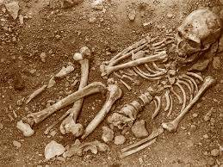
River Valley Religions Review
Paleolithic Era – animism and shamanism
Burial sites indicate belief in afterlife

Slide 6
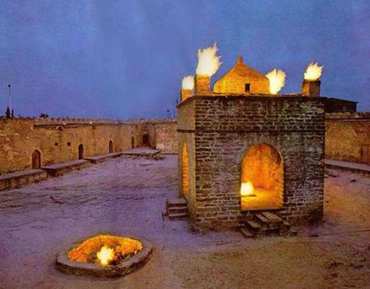
R.V. Religious Review
Early Civilizations
Vedic religion→ Hinduism
Hebrew monotheism→ Judaism
Zoroastrianism→ Christianity

Slide 7
Classical Religions Overview
Codification of existing belief systems
Monotheism = Judaism and Zoroastrianism
Aryan Vedic Religion = Hinduism

Slide 8
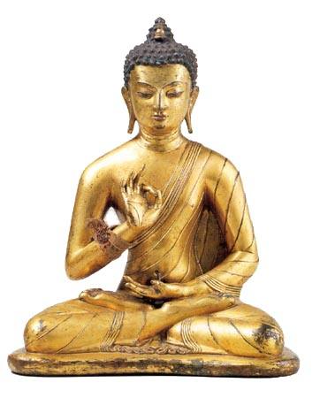
Religious Overview
New belief systems
Christianity
Buddhism
Daoism
Confucianism
Greco-Roman Rationalism
* Why so many new belief systems around same time?

Slide 9
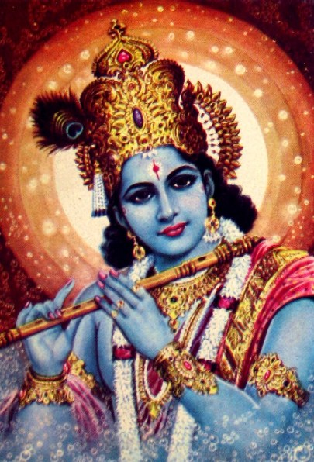
Hinduism
Background
Started in India (spread to SE Asia)
brought by Aryans from Central Asia
No founder; very diverse
Codified in Sanskrit 500BCE
Beliefs
Brahman = supreme soul (God) that takes many forms (polytheistic)
Karma (actions), Dharma (duties), Samsara (rebirth), Moksha (enlightenment)
Caste System – rigid social system
Patriarchal

Slide 10
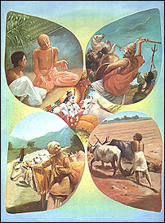
Hinduism
Caste System
Varnas = caste
Brahmins: priests and scholars
Kshatriyas: kings, governors, warriors and soldiers
Vaishyas: herders, farmers, artisans and merchants
Shudras: peasants, laborers and service providers
Dalits: untouchables (no caste)
Jatis = clan, tribe, family, or community subgroups within each varna
Caste system discouraged rebellion and justified social and political status quo.

Slide 11
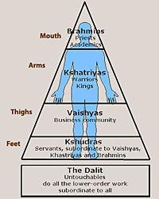
Hinduism
Caste System
Caste determines dharma
Karma is earned based on performance of dharma
Karma determines next caste in cycle of samsara = reincarnation
Brahmin (priests) who earned enough karma to fulfill their dharma reached moksha

Slide 12
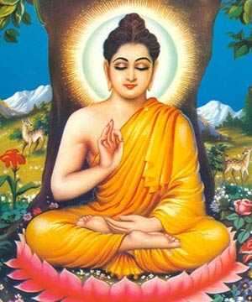
Buddhism
Founder
Siddhartha Gautama
Kshatriya who left caste to pursue enlightenment
Teachings were recorded into sutras
Based on Hinduism
Accepted Karma, Dharma, and Samsara
Rejected caste system
Beliefs
4 Noble Truths (to prevent suffering desire must be eliminated)
Eight-fold Path (8-step “right life” to reach nirvana)
Nirvana = enlightenment (escape from cycle of rebirth)

Slide 13
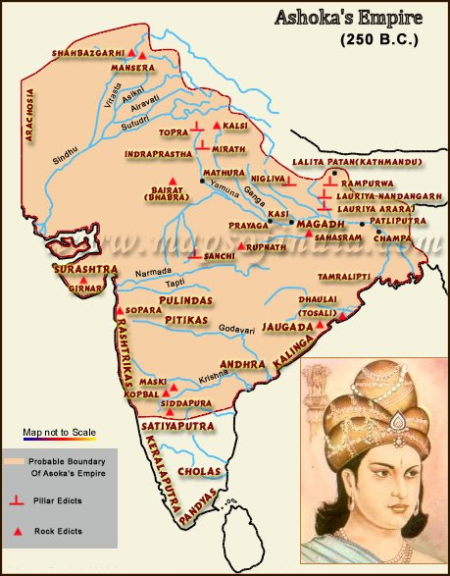
Buddhism
Spread of Buddhism
Universal religion
sought converts
Appealed to subordinate social groups (women and poor)
Spread throughout East and Southeast Asia
Mauryan Emperor Ashoka
missionaries and merchants
educational institutions (schools, temples, monasteries, etc.)

Slide 14
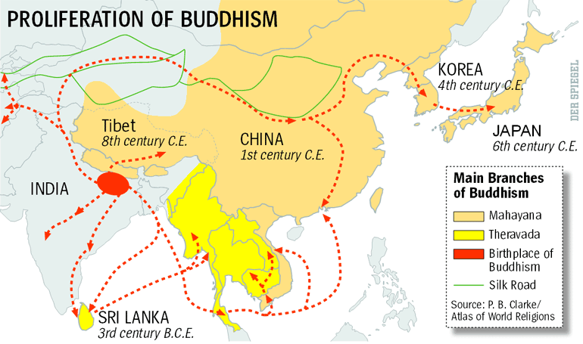

Slide 15
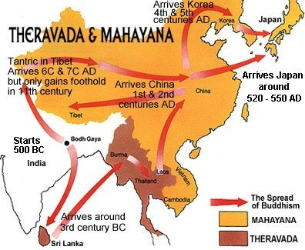
Buddhism
Branches
Theravada = Teachings of the Elders
Mahayana = Great Vehicle

Slide 16
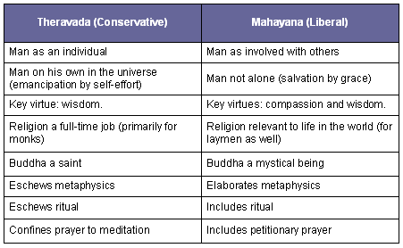
Theravada v. Mahayana

Slide 17
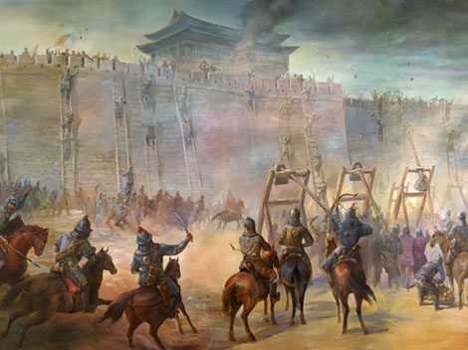
China
Decline of Zhou Dynasty
Age of Warring States (403—221 B.C.E.)
Disorder and turmoil
Need to restore order and tranquility

Slide 18
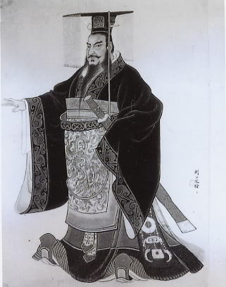
Legalism
Background
3rd century BCE
Founder Shang Yang
Book of the Shang
Beliefs
Harsh but fair rules and laws
system of rewards and punishments
Most people are naturally bad, stupid and shortsighted
Government needs to be strong
Emperor Shi Huangdi of Qin Dynasty

Slide 19
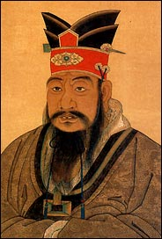
Confucianism
Background
6th century BCE
Rulers must lead by example
Founder Confucius (Kong Fu Zi)
Widely adopted by Han Dynasty from 3rd century BCE to 3rd century CE
The Analects
Beliefs
Social harmony through proper interpersonal relationships
5 basic relationships
Ruler and subject
Father and son
Elder brother and younger brother
Husband and wife
Friend to friend
Ren (goodness, nobility of heart) could be cultivated through education and ceremony.
Filial Piety – respect/obey elders/family
Mandate of Heaven

Slide 20
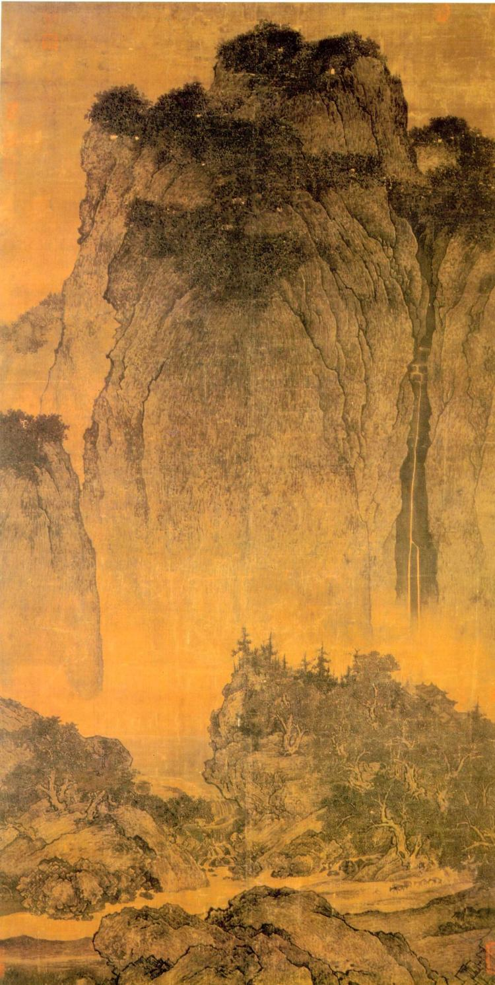
Daoism
Background
6th century BCE (Zhou Dynasty)
Founder Laozi (Lao Tzu), former bureaucrat who became a wandering hermit
Daodejing
Beliefs
Dao= the way of nature
Yin and Yang = two equal, opposing forces which balance the universe (dark/light, male/female)
Natural force created by and existing within all living things
People should seek to live a simple life in harmony with nature
Social and political organization is unnecessary as it distracts from seeking universal harmony
Yellow Turban Rebellion against Han Dynasty in 3rd century CE

Slide 21
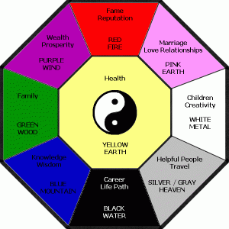
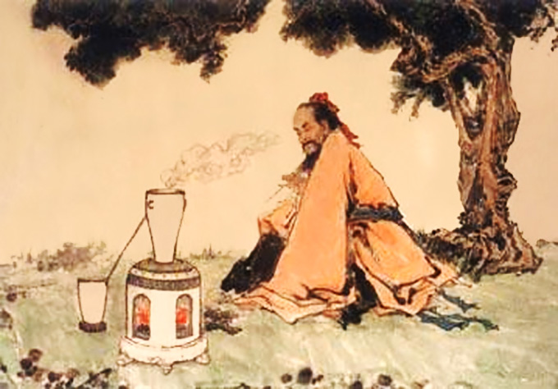
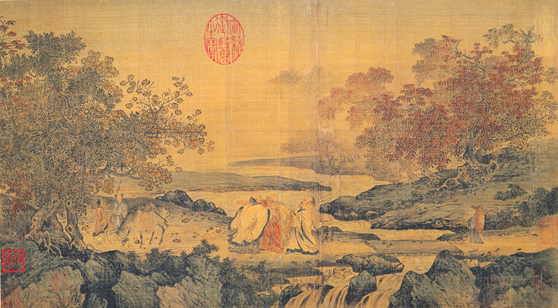
Influence of Daoism on Chinese Culture
Medical theories and practices
Poetry
Metallurgy
Architecture

Slide 22
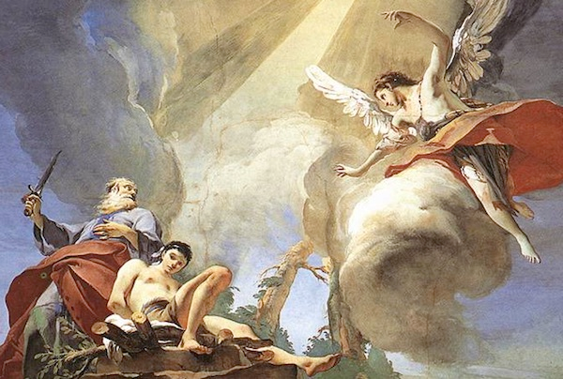
Judaism
Background
9th – 8th centuries BCE
Mesopotamia and Israel
Abraham
Beliefs
Elitist religion – Covenant/agreement with God
Torah (holy book) codified 500 BCE
Also reflected the influence of Mesopotamian cultural, religious, and legal traditions

Slide 23
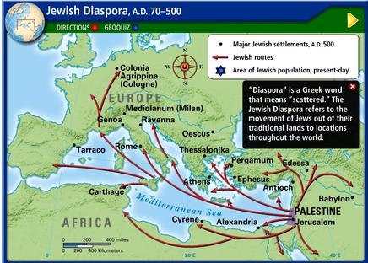
Jewish Diaspora

Slide 24
Jewish Diaspora
The Assyrian, Babylonian, and Roman empires conquered various Jewish states
772 B.C.E. - conquered by Assyria
586 B.C.E - fell to Babylonians
70 C.E. – Romans destroy temple
Contributed to growth of Jewish diasporic communities around the Mediterranean and Middle East.
Diaspora: migration of people from established homeland

Slide 25
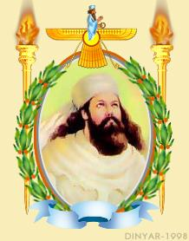
Zoroastrianism
Background
7th century BCE
Persian prophet Zarathustra (Zoroaster)
Avestas
Beliefs
Ahura Mazda (God of goodness and light) verses Angra Mainyu (forces of evil)
A human savior would aide Ahura Mazda’s ultimate victory (Messiah)
Judgement Day – heaven and hell
Elitist religion – did not seek converts
Nearly wiped out as a major religion during Arab conquests of Persian Empire
influences can be seen in Judaism, and subsequently Christianity and Islam

Slide 26
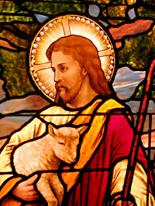
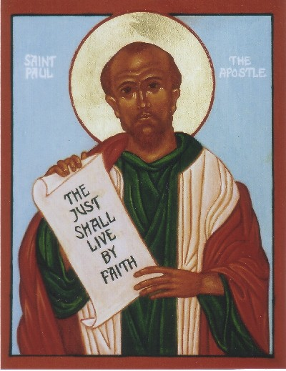
Christianity
Background
Jesus of Nazareth 30 CE
Sought to reform Judaism
Relied on older Judaic traditions but tried to appeal to non-Jews
Beliefs
Jesus is the Son of God chosen to redeem humankind
Believe in nonviolence and fair, benevolent treatment of all people
1st persecuted by Romans, become official religion of empire in 380 CE Constantine
Universal religion: spread through missionaries (St. Paul), trade, Roman Roads
Spreads throughout Mediterranean Region

Slide 27
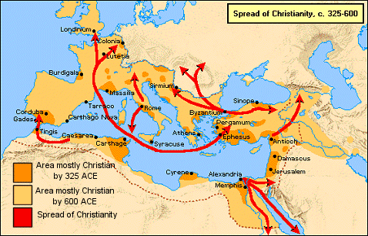
Diffusion of Christianity

Slide 28
Comparing Christianity and Buddhism

Slide 29
Lets Practice
How did religion change from the River Valley Period to the Classical Period?
Write 3 thesis statements comparing religions of the Classical Age.

Slide 30
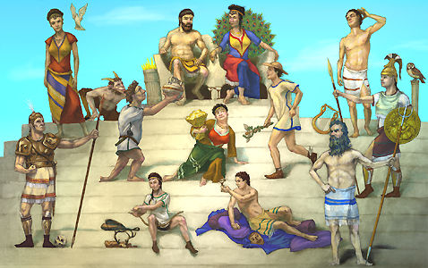
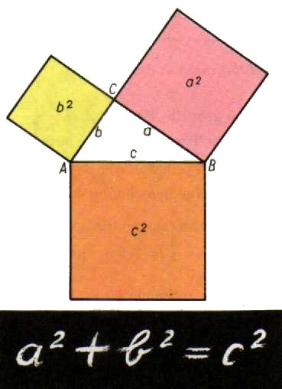
Greco-Roman Rationalism
Background
5th and 4th centuries BCE
Socrates, Plato, Aristotle
Beliefs
Use of logic, observation, and questioning to make sense of the universe
Established a secular tradition: separated science and philosophy from religion.
Sought to explain natural occurrences and replace mythological beliefs
Used subsequently by Hellenistic, Roman, Persian, and Islamic Empires

Slide 31
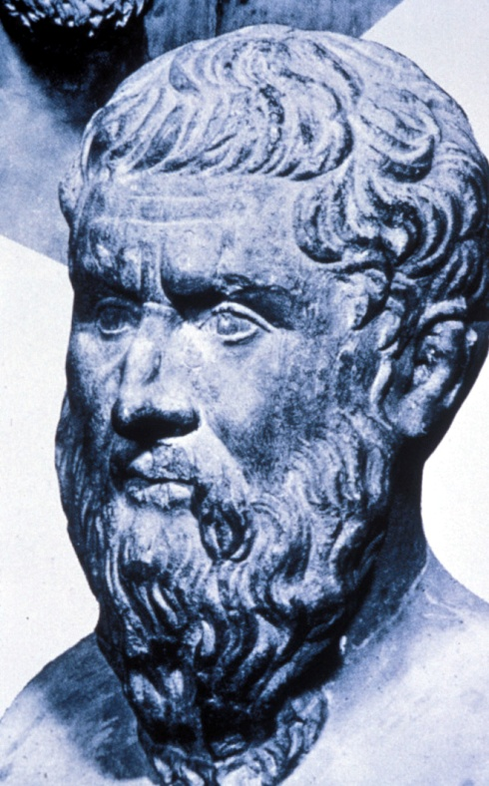
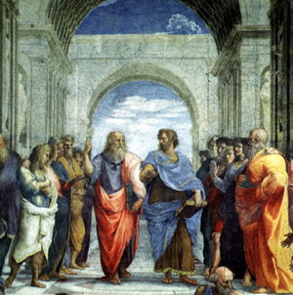
Philosophers
Socrates: Athenian philosopher known for questioning his student’s logic, put to death for criticizing government and “corrupting the youth”
Plato: concerned with ethics/government, The Republic: a good society would be ruled by a class of guardians led by a philosopher-king
Aristotle: student of Plato, taught Alexander the Great; “virtue” could be learned; wanted a mixed system of monarchy, aristocracy, and democracy

Slide 32
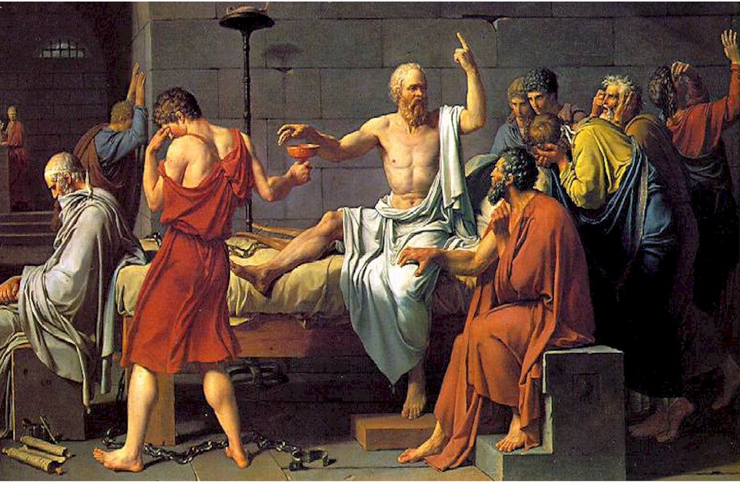
The Death of Socrates: Condemned to death by an Athenian jury, Socrates refused to go into exile, drinking a cup of poison hemlock and dying in 399 B.C. in the presence of his friends (Jacques-Louis David, 1787).

Slide 33
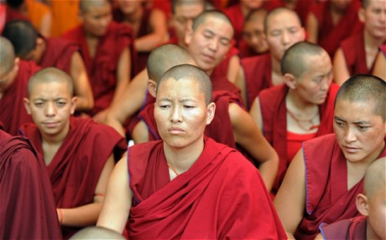
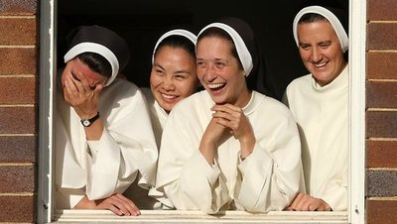
Religion and Gender
Belief systems affected gender roles
Buddhism and Christianity encouraged monastic life
Monastic life- living in religious orders apart from society
“Fun to be a nun” – nuns had more control over their daily lives than married women
Confucianism emphasized filial piety.

Slide 34
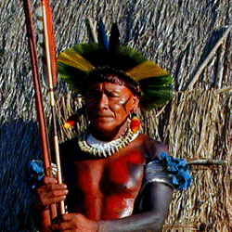
Continuity
Other religious and cultural traditions continued
Shamanism and animism continued to shape people’s lives because of their daily reliance on the natural world.
Ancestor veneration persisted in many regions.
Africa
The Mediterranean region
East Asia
The Andean areas

Slide 35
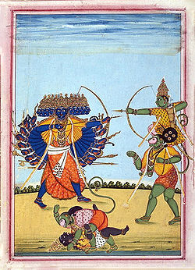
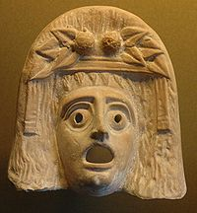
Literature and Drama
Literature, drama, architecture, and sculpture, show distinctive cultural developments.
Influenced artistic developments in neighboring regions and in later time periods
Greek plays
Indian epics
Mask of Dionysus
Ramayana: Rama (on Hanuman) battles demon-king Ravana

Slide 36
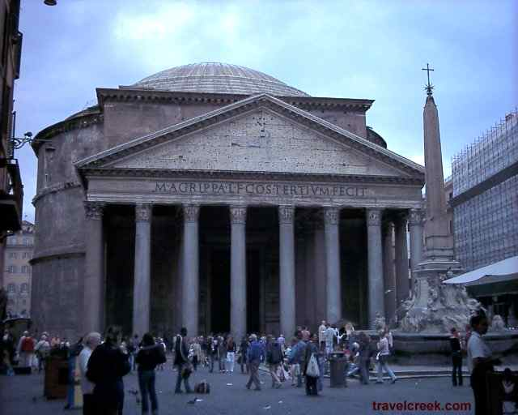
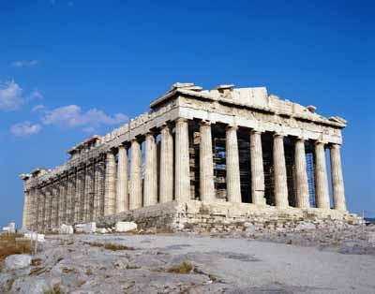
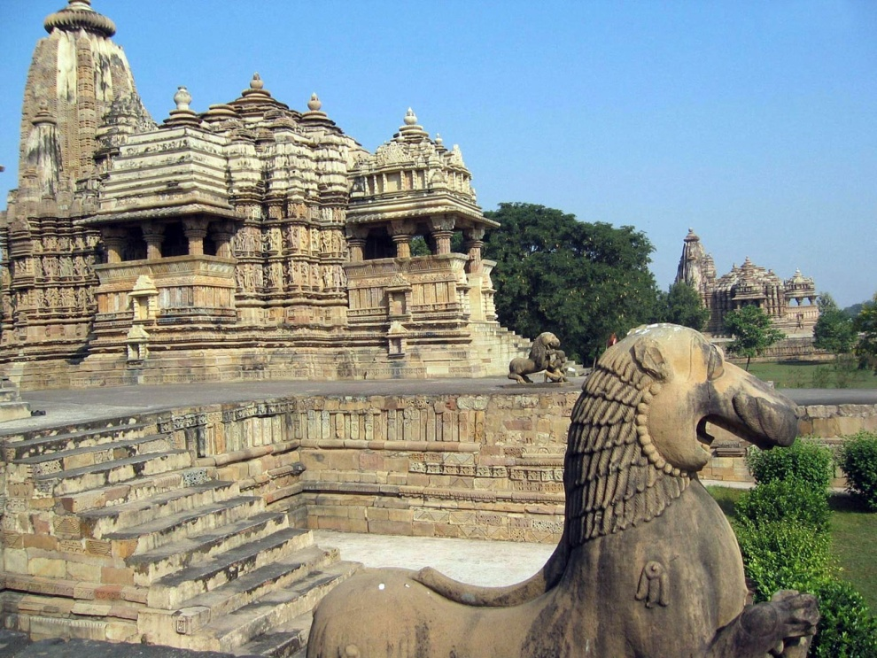
Architecture
Indian
Greek
Roman

Slide 37
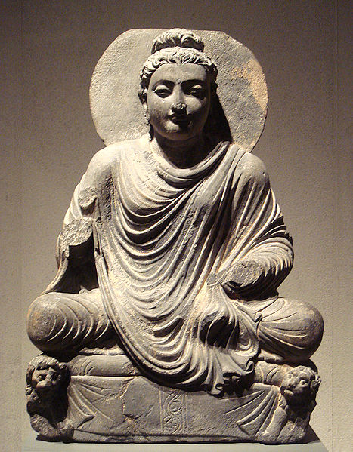
Syncretism
The convergence of Greco-Roman culture and Buddhist beliefs affected the development of unique sculptural developments.
Gandhara Buddhas exemplify a syncretism
Gandhara: region of today’s Afghanistan/Pakistan
Syncretism: combining or merging discrete traditions or contrary beliefs
Hellenistic veneration for the body is combined with Buddhist symbols
1st-2nd century C.E.

Slide 38
