Slide 1
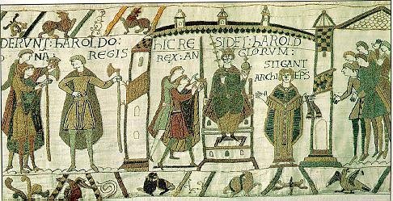
Chapter 10:
A New Civilization Emerges in Europe

Slide 2
THE MIDDLE OF WHAT?
THE PERIOD CALLED THE MIDDLE AGES IS BETWEEN THE FALL OF ROME AND THE RENIASSANCE
ABOUT 400 C.E. TO 1400 C.E.
IT’S A PERIOD OF RECOVERY AND GROWTH,DECLINE, GROWTH AGAIN…

Slide 3
Where is it?
Civilization comes to parts of Europe that had been left out of Rome
Germany, Northern Britain, Scandinavia…
It gradually spreads to cover all of Western Europe

Slide 4
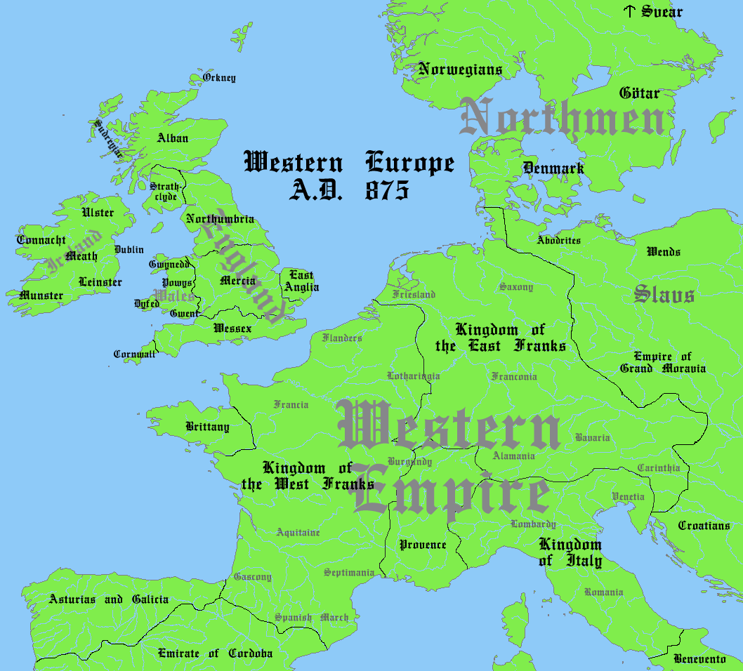

Slide 5
SOCIETY AND CULTURE IN THE MIDDLE AGES
THE CENTER MOVES AWAY FROM ROME NORTHWARD
COMPARD TO THE REST OF THE WORLD EUROPE WAS PRIMITIVE
MUSLIMS SCORNED THEM AS ‘BARBARIANS’
THIS HELPS EXPLAINS SOME OF THE CONFLICTS WITH ISLAM

Slide 6
EUROPE BEGAN TO GROW AGAIN
POPULATIONS ROSE
NEW TECHNOLOGIES DEVELOPED
WATER DRIVEN MILLS, IRON CASTING
CHRISTIANITY BECAME THE DOMINANT FAITH, CENTERD IN THE ROMAN CHURCH

Slide 7
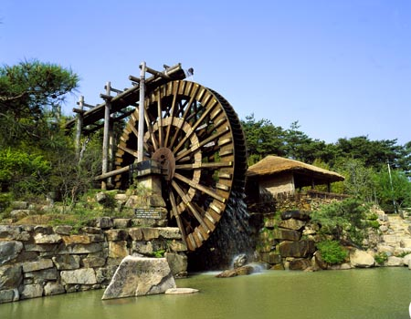

Slide 8
THE CHRUCH WAS THE CENTER OF LIFE
THE FOCUS WAS ATTAINING SALVATION
LEARNING WAS RESTRICTED TO THE CLERGY IN GENERAL

Slide 9
ITALY WAS A FRAGMENTED WEAK AREA- ROME HAD BEEN SACKED
THE WEST REMAINED VUNERABLE TO INVASIONS- VIKINGS
OVERALL, FOR 500 YEARS WESTERN CULTURE DID NOT ADVANCE AS FAST AS THE REST OF THE WORLD

Slide 10
Story Time p. 157 “Medieval Europe, 1000-1500”
Take Notes on Medieval Europe
  -
  -
  -
Overview of Middle Ages:
Fall of Western Rome (5th c.) - decline of Europe’s feudal and religious institutions (15th c.)
  Early Middle Ages (5th-10th): period of decline
  High Middle Ages (10th-15th): period of slow emergence
Age of great faith (Christianity) with strong participation, and fervent spread of beliefs by missionaries
Increasing participation in trade with Asia and Africa.
In High Middle Ages, contact with Byzantines and Arabs through Crusades teaches Western scholars advances in math, science, philosophy.

Slide 11
THE MANORIAL SYSTEM: a self sufficient economy
MANORIALISM IS AN ECONOMIC SYSTEM
STARTED IN THE LATE ROMAN EMPIRE TO INCREASE AGRICULTURE
SERF- PEASANT LEGALLY TIED TO THE LAND
LORDS OWNED THE LAND

Slide 12
IN RETURN FOR WORKING THE LAND, SERFS WERE PROTECTED BY THE LORDS
SERFS HAD TO GIVE PART OF EVERYTHING THEY GREW OR MADE TO THEIR LANDLORD
ITS A HARD LIFE, BUT ITS A DANGEROUS WORLD

Slide 13
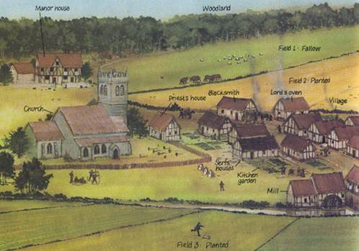
Manorialism

Slide 14
A SERF’S LIFE
SERFS WORK WITH FAMILIES
OWNED THEIR OWN HOMES, NOT THE LAND
COULD PASS PROPERTY ON
COULD NOT LEAVE W/O LORDS PERMISSION
THEY ARE NOT SLAVES-THEY CANNOT BE SOLD

Slide 15
SOME ADVANCES
OLD PLOWS REPLACED WITH MOLDBOARDS- CURVED IRON PLOWS
THE THREE-FIELD SYSTEM INCREASES PRODUCTION

Slide 16
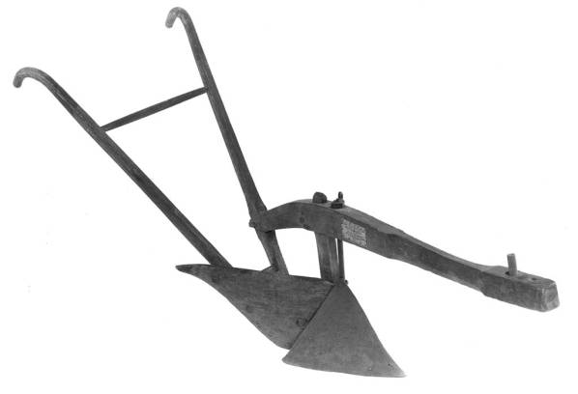

Slide 17
THE CHURCH- SPRITUAL AND POLITICAL POWERS
THE CHURCH FUNCTIONED AS A ‘GOVERNMENT’ ACROSS EUROPE
IT INTERFERES WITH KINGS POWERS, REGULATES TRADE, HAS A HAND IN MAY AREAS OF LIFE
VIEWS ITSELF AS ABOVE LOCAL KINGS AND RULERS

Slide 18
MANY KINGS SUCH AS CLOVIS CONVERT TO GAIN AN ALLY IN THE CHURCH
THE CHURCH ATTEMPTS TO PRESERVE ANCIENT LEARNING
SALVATION IS THE CENTRAL THEME FOR LIFE ON EARTH

Slide 19
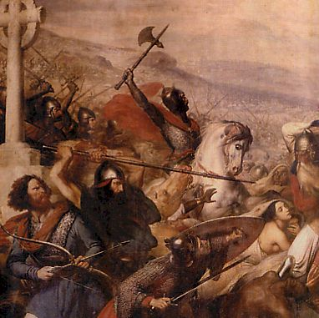

Slide 20
Story Time “Medieval Society & Government” p. 159
  Take Notes
    -
    -
    -
    -
    -

Slide 21
In 732 at the Battles of Tours and Poitiers
The Franks under Charles Martel (the Hammer) defeat the Muslims who had been advancing north from Spain.
By the late 900s the Vikings and Magyars (Hungarians) had converted to Christianity and settled down to become Europeans
This creates Stability and creates an atmosphere for renewed TRADE

Slide 22
Trade Revives
This population explosion meant that people needed/wanted new things from other places.
Armed caravans began to move along new trade routes.

Slide 23
Trade brings changes
Trade → Trade Fairs → New Towns
New money
Business: Partnerships, insurance, banking, bills of exchange, etc.

Slide 24
Trade brings changes
Social Changes
  Serfdom disappears, tenant farmers by 1300.
  Merchants, traders form up the middle class.
  Loans, or usury

Slide 25
Guilds
Guilds were associations of artisans and merchants of similar economic interests.
How to become a guild member?
  Apprentice
  Journeyman
  Women?

Slide 26
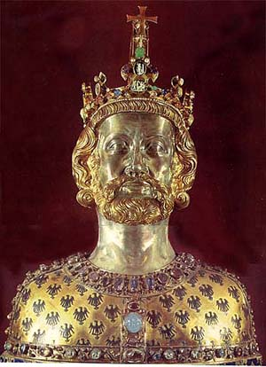
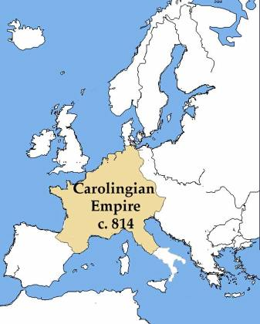
Charlemagne and the Carolingians
Charlemagne
  800, establish empire in France and Germany
  Pope’s coronation of Charlemagne as first Holy Roman Emperor sets precedent that Church approval is necessary for Western political power
  843: Treaty of Verdun (empire fragments into three kingdoms)
    Provides a small amount of stability, but power of emperor was limited
    Most of Germany still run by feudal lords and most of Italy in city-states

Slide 27
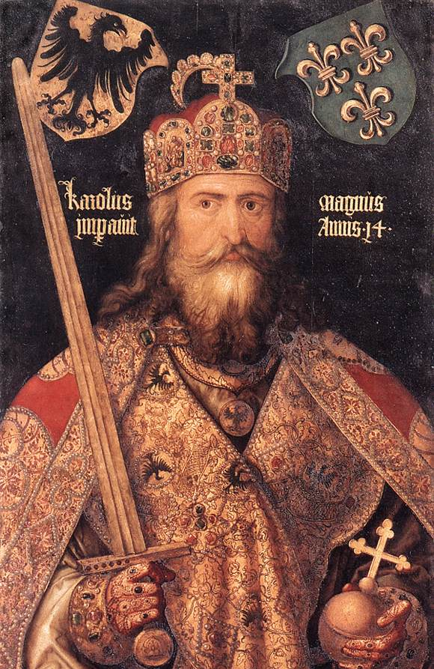
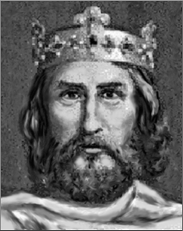
CHARLEMAGNE

Slide 28
FOR THE TIMES A VERY BIG MAN, OVER SIX FEET. SMART, SHREWD, DEVOUT
HE SOUGHT TO REVIVE ROME
THIS IS A GOAL FOR MANY LEADERS FOR A LONG TIME
HE UNITED MUCH OF PRESENT DAY WESTERN EUROPE
HE IS CROWNED AS THE EMPEROR OF ROME BY THE POPE
THE POPE GIVES HIM THE CROWN, SETTING UP A STRUGGLE FOR POWER WITH ALL FUTURE RULERS
HE TRIED TO ADVANCE LEARNING, BUILT A GREAT SCHOOL AT AACHEN

Slide 29
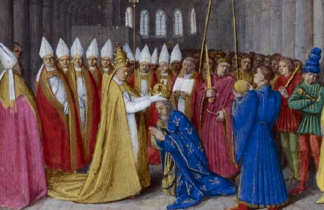

Slide 30
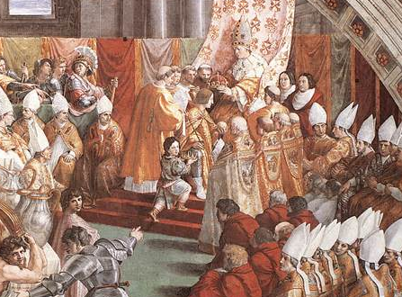

Slide 31
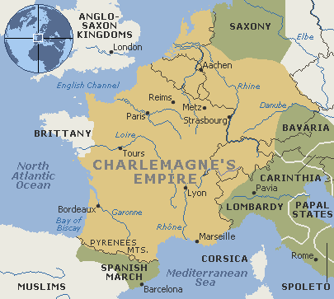

Slide 32
AFTER HIS DEATH, HIS EMPIRE FELL APART…SOUND FAMILIAR?
AFTER HIM EUROPE SETS A PATTERN OF REGIONAL RULERS WHO COMPETE FOR POWER, NEVER REUNITED
THE TITLE EMPEROR REMAINS, BUTS ITS JUST A TITLE
ONLY CHRISTIANITY TIES EUROPE TOGETHER

Slide 33
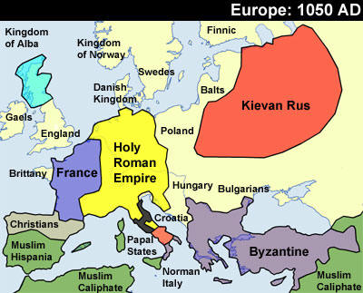

Slide 34
Feudal Monarchies
Military and political system
  Based on military alliances
  Rulers provided protection and aid to lesser lords (vassals)
  Vassals owed rulers military service; goods; payments; counsel; sometimes receive land
Growth of strong feudal monarchy in Europe took many centuries
Absorbs manors into larger kingdoms
Result: regional monarchies with strong aristocracies
Growth of the feudal societies mirrored the same system in place in China
William the Conqueror, Duke of Normandy
  Introduced feudal monarchy to England following Norman invasion in 1066 (Battle of Hastings)
  Declares that vassals must swear allegiance to him, not to lords

Slide 35
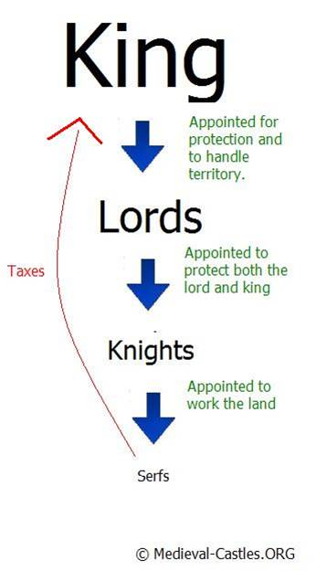
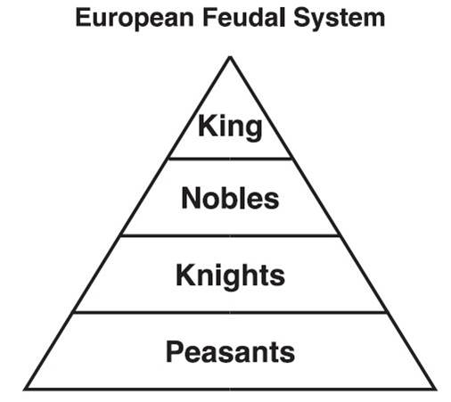

Slide 36
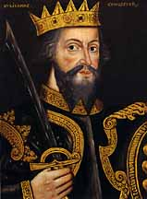
WILLIAM THE CONQUEROR

Slide 37

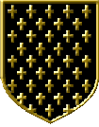
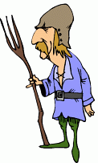
PROTECTION
AND LAND
TAXES AND KNIGHTS

Slide 38
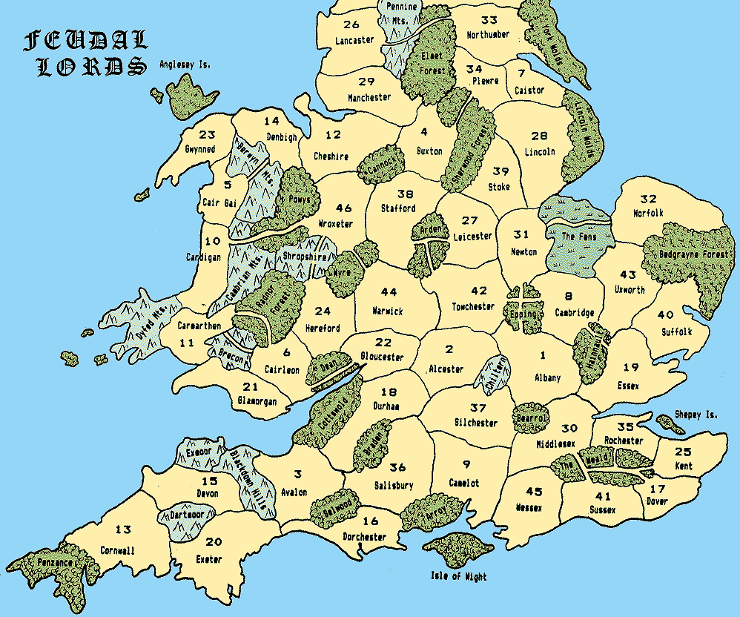

Slide 39
NOT ALL OF EUROPE HAD STRONG SYSTEMS
NORTHERN GERMANY, THE LOW COUNTRIES, AND ITALY REMAINED FRAGMENTED AND WEAK
1215* IN ENGLAND THE MAGNA CARTA BEGAN LIMITING ROYAL POWER
PARLIAMENTS START IN EUROPE- VERY LIMITED IN POWER

Slide 40
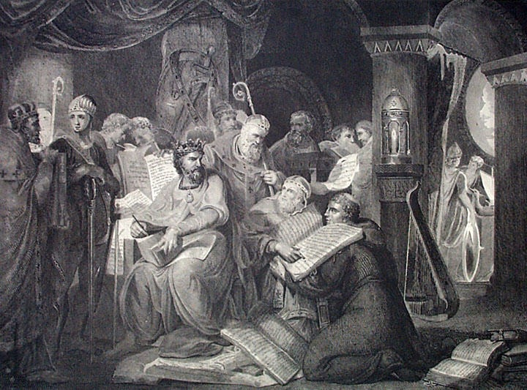

Slide 41
IN GENERAL MOST PEOPLE HAD LIMITED RIGHTS
IT WAS A BEGINNING TO LATER GOVT’S POWER STRUCTURES
THEY WERE LOOKING FOR A BALANCE OF POWER BETWEEN LORDS AND VASSALS

Slide 42
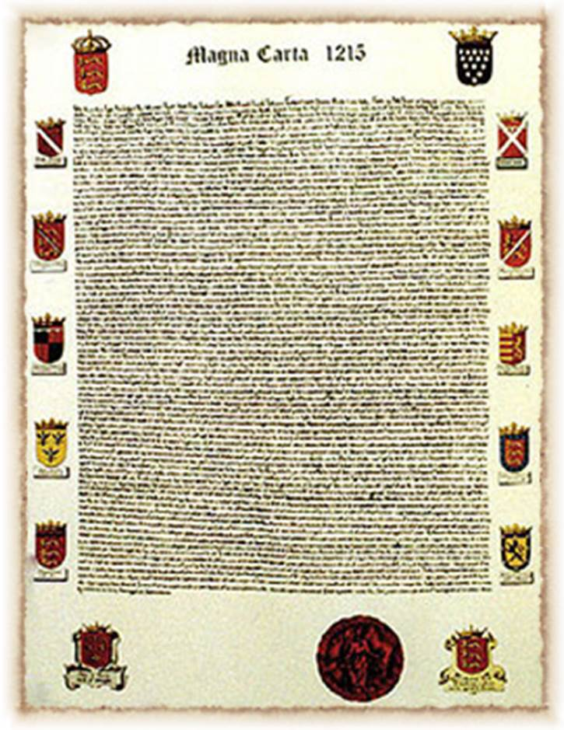
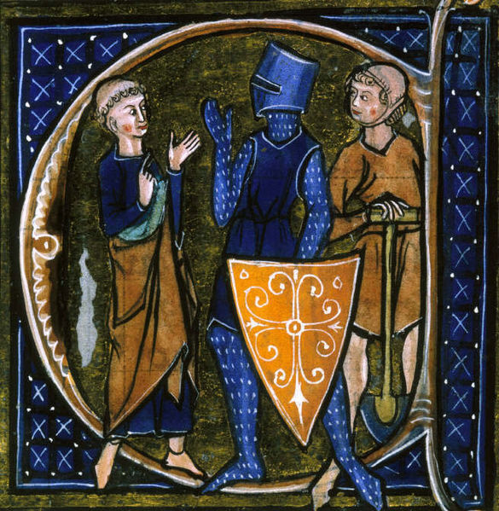
Limiting Government
Growth of monarchy cut into aristocratic power, so attempts are made to limit monarchical power
1215: Magna Carta
  King John recognizes supremacy of written law; was forced by noblemen to adhere to it
  Granted basic rights to noblemen
1265: first English Parliament
  Serve as check on royal authority; collaboration between king and vassals
Three Estates (Church, Nobles, Commoners)
  Rights according to estate in which you were born
However, monarchs continue to increase in power
  Large conflicts like Hundred Years War lead to early ideas of nationalism with kings are leaders that embody countries’ principles

Slide 43
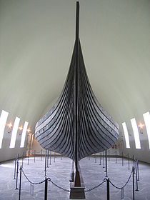
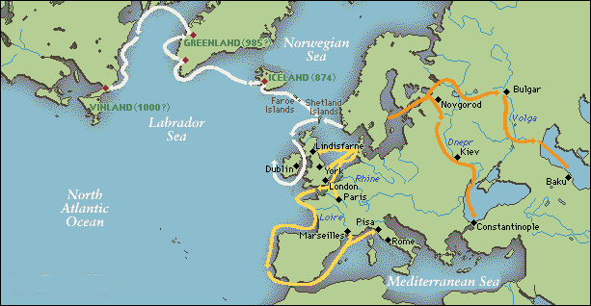
Vikings
Danish; Norwegian; Swedish
Raids from 8th to 11th centuries
Lightweight boats with wide hulls; stable and easily handled in rough water
10th c.: Begin to cease raids, convert to Christianity, and become settled peoples in Europe.
  Continue to explore northern Atlantic (Iceland; Greenland; North America)
  First European steps in Americas, Hudson Bay area

Slide 44
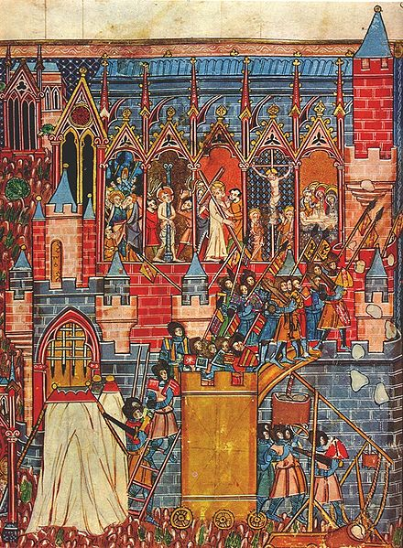
Crusades
Crusades
  Called by Urban II, 1095; end Muslim (Seljuk Turk) control of Holy Land
  Initial success but ultimately end with defeat
  Pass through Byzantine Empire (architectural achievements)
  New contact with Islam and open western Europe’s eyes to new possibilities, especially trade
    Sugarcane, spices, porcelain, glassware, carpets from East
    Unbalanced trade: West wants Eastern goods
  Show aggressive spirit of Western Europe

Slide 45
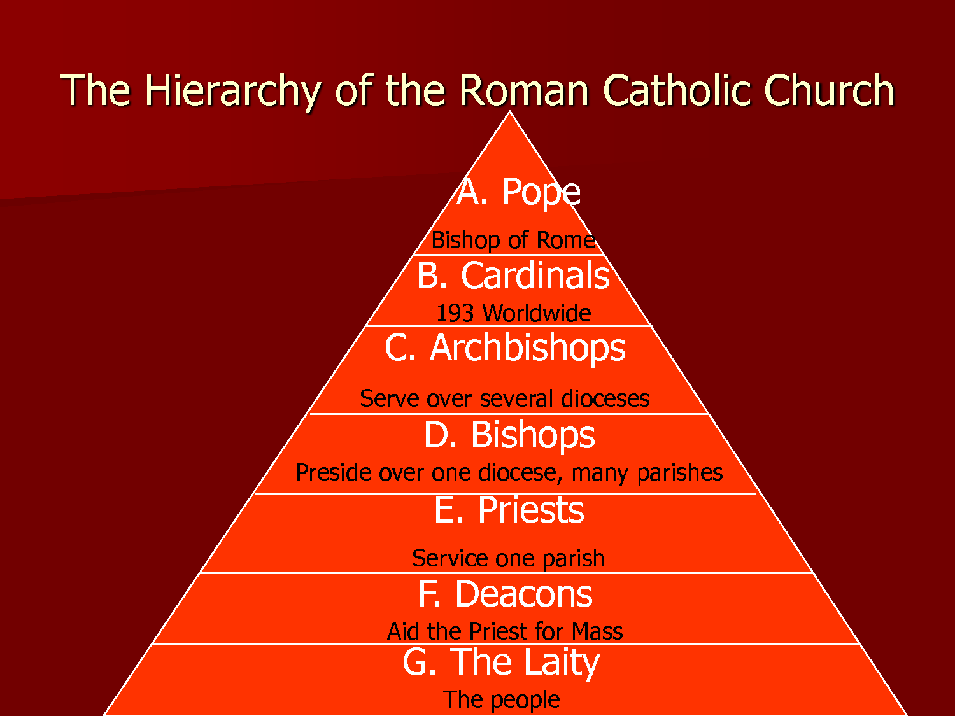
The Catholic Church
Catholic Church becomes most powerful and wealthy institution in West
  Opportunities for abuse and corruption
  Church sometimes owned large landholdings
Clear hierarchy of Church power like Roman government
Popes regulated doctrine
  Just like “Royal Cult” of Islam, early Germanic kings were interested in Christianity

Slide 46
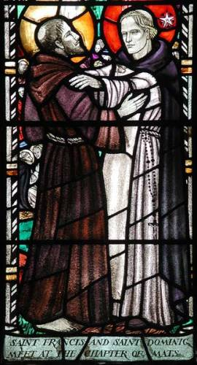
Religious Reform
1073-1085: Gregorian Reform with Gregory VII
  Separation of secular and religious spheres
  Try to free church from interference from states
  Prove Church is superior to state
  Quarrels with HRE Henry IV over investiture (whose right is it to appoint bishops? King or Pope?)
Several reform movements created to combat perceived corruption in Church
  Mendicants, 13th century
    St. Francis (Franciscans)
    St. Dominic (Dominicans)

Slide 47
CHURCH REFORM
SOME SAW THE CHURCH AS BECOMING CORRUPT. SECULAR
ONE REFORM WAS MONASTICISM
POPE GREGORY VII TRIED TO TAKE POWER TO APPOINT BISHOPS FROM RULERS- LAY INVESTITURE
THE HOLY ROMAN EMPEROR DID NOT WANT TO GIVE UP CONTROL

Slide 48
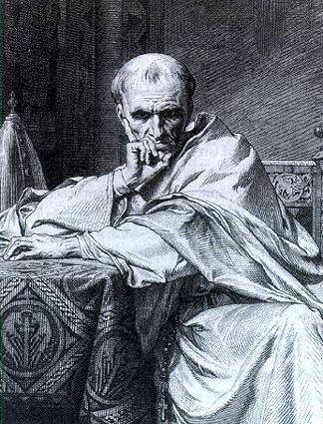
POPE GREGORY VII

Slide 49
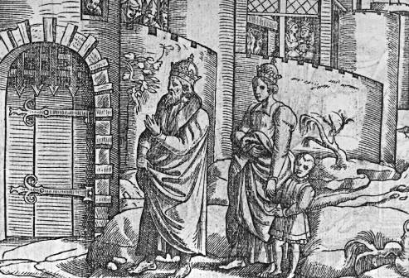

Slide 50
THE COMPROMISE- POPES APPOINT BISHOPS, RULERS GRANT THE LAND
OTHER POPES TRIED TO MAKE THE CHURCH SUPREME OVER KINGS
THE CHURCH HAS ITS OWN COURTS TO RULE ON RELIGIOUS LAWS
IN EFFECT TWO GOVERNMENTS- CHURCH AND STATE

Slide 51
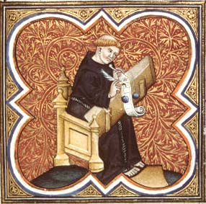
Monasticism
Aide in discipline of intense spirituality of devout Christians through celibacy and extreme piety
Example of holy life to ordinary people
Monasteries were pilgrimage centers
Intellectual life and literacy declines except among churchman in monasteries
Benedict of Nursia, 6th c.
  Creates Benedictine rule for monks
  Founder of Western monasticism

Slide 52
The High Middle Ages
11th - 15th centuries: emergence from the Dark Ages
  Increased urbanization and declining manorialism
    Increased social mobility
  Increased trade with Asia
  Increased economic activity and banking
  Increased universities
  Declining feudal political structures and emerging centralized monarchies
  Strengthening of nation-states (Hundred Years’ War)
  New warfare technology

Slide 53
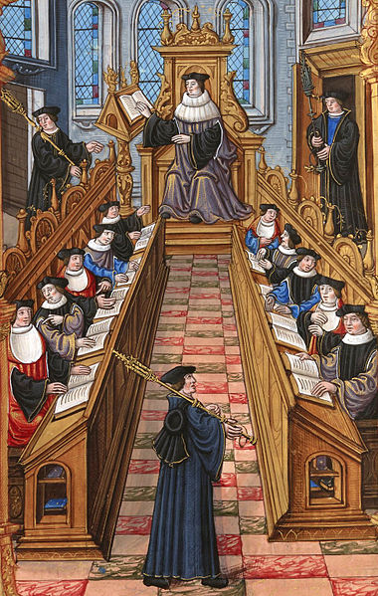
Urbanization and Education
Population increase, towns grow
  Growing economy and markets
  Literacy expands in urban centers
  Decreasing Viking raids
Emphasis on education
  From 11th c: Cathedral schools trained children to be future clergy members
  From 13th c: Universities trained students in theology, medicine, law
Help to create economic and cultural vitality in Europe after 1000

Slide 54
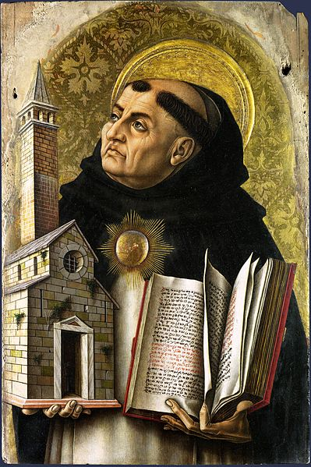
Theology
(Assimilating Faith and Reason)
Exploration of Greek philosophy and assimilation into Catholic religious tradition
Debate in universities: how to combine rational philosophy with Christian faith?
Bernard of Clairvaux, monk
  Opposed to approach of integration of Greek philosophy into Catholic tradition
  Supports mysticism (receive truth through faith and union with God)
Thomas Aquinas, Summas
  faith is primary, but reason leads to understanding; therefore, one can reconcile Greek philosophy with Catholic theology
  Scholasticism, 13th c., logic to resolve theological problems

Slide 55
THEOLOGY
THE CHURCH RELIED ON ANCIENT LEARNING- ARISTOTLE
FAITH WAS SUPREME OVER REASON
AS SCHOLARS TRANSLATED ANCIENT TEXTS,LEARNING INCREASED
PEOPLE VENERATED SAINTS,WENT TO CHURCH, BUT MAGIC AND SUPERSTITION STILL REMAINED ALIVE

Slide 56
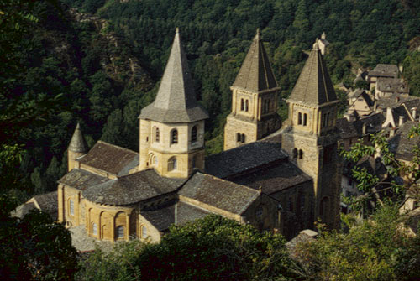
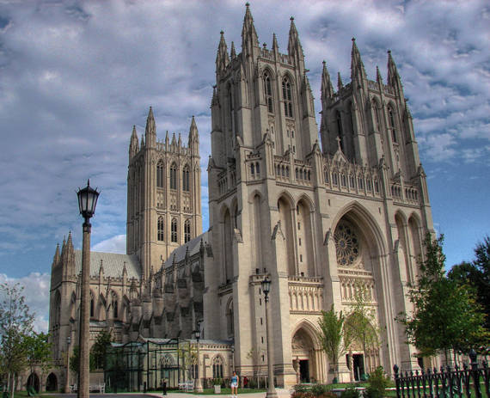
Religion in Art and Literature
Architecture, literature, and art reflect religious themes
Painting: wood panels, religious scenes, no perspective
Romanesque architecture: for pilgrimages, blocky, “Roman”-like
Gothic architecture: 11th c., verticality, light, intricacy, growing technical skills, expensive
Literature
  Latin: law, education
  Vernacular: secular literature (Chaucer’s Canterbury Tales; Beowulf)
  Court poetry and chivalry

Slide 57
ART
ART REMAINED CENTERED ON SALVATION AND THEMES OF RELIGIOUS FAITH
CATHEDRALS BECOME GIANT CENTERS OF FAITH AND WORSHIP

Slide 58
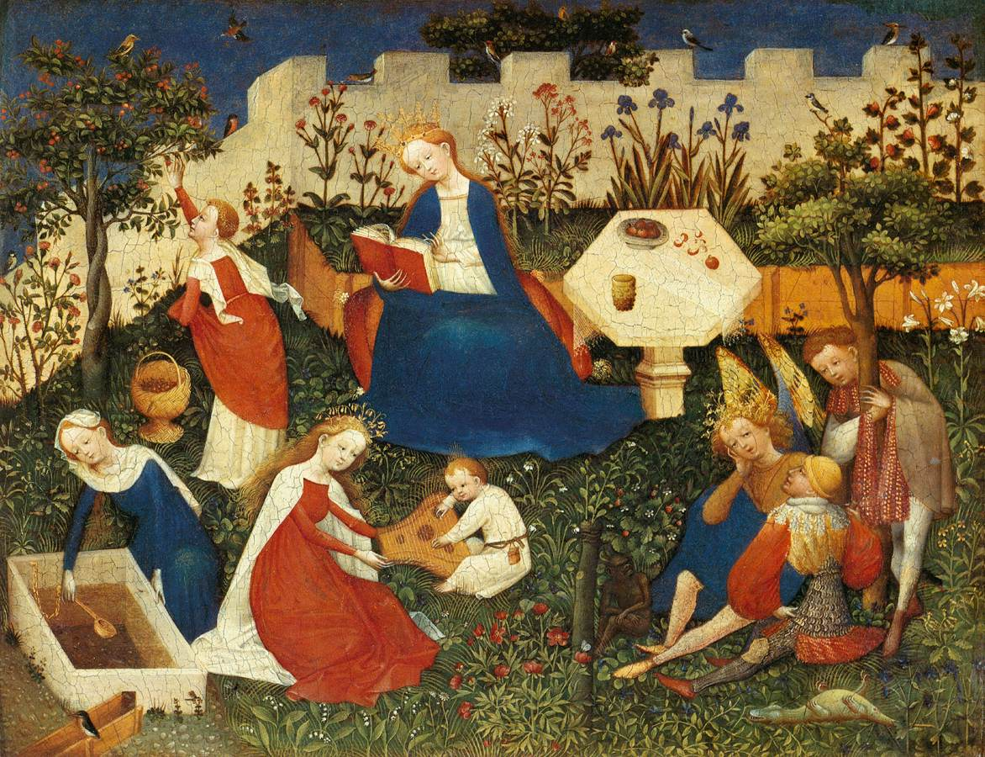

Slide 59
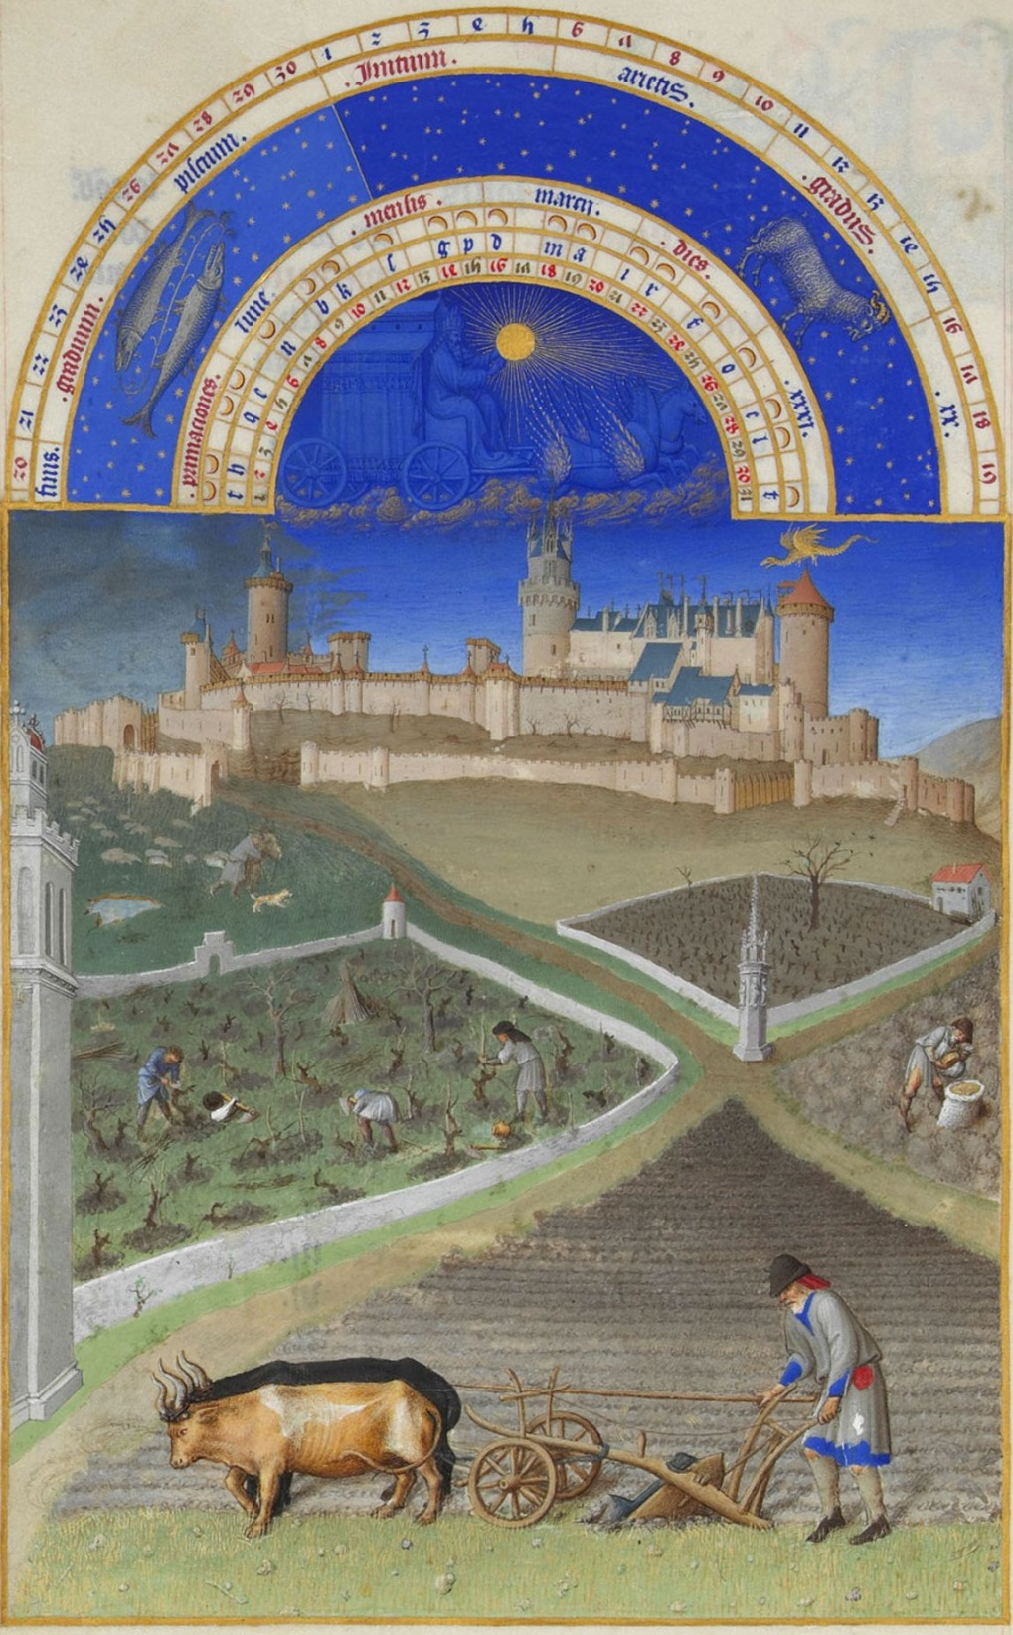
Agricultural Innovations
Moldboard: curved iron plate, allowed deeper turning of heavy soil
Crop rotation: leave half of land uncultivated each year to restore soil, but limits productivity
Three-field system: Only 1/3 of land left unplanted
Agricultural improvements → increased production → population growth → increased size of urban areas
Peasants gain financial freedom with agricultural advances, some become free farmers with no landlord and move to cities
Moldboard and Crop Rotation

Slide 60
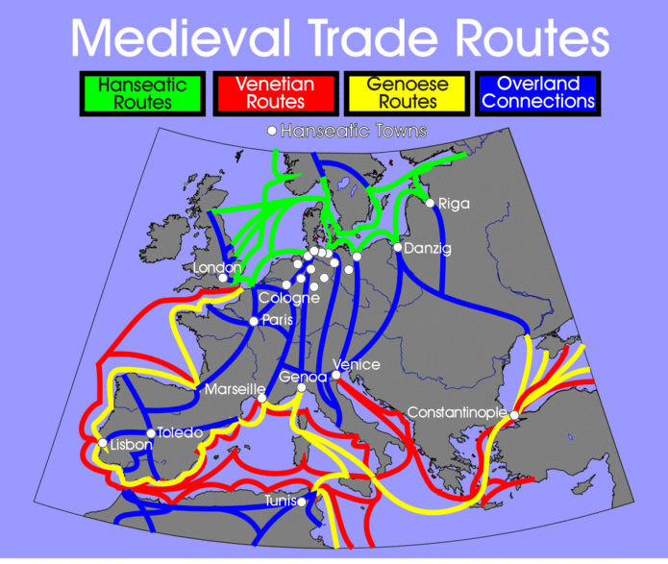
Growth of Trade and Banking
Low Countries: cloth; England: wool; France: wine; Scandinavia: timber; fish; fur
Money replaces barter system, and banking and insurance emerge
Hanseatic League
  Confederation of merchant guilds and cities in Northern Europe working together for mutual economic benefit
Merchants asserted considerable power in trading cities as weak governments failed to regulate merchants
Merchants have low social status however; Christians raised concerns about capitalism and greed

Slide 61
TRADE AND TOWNS
MORE PEASANTS ARE GAINING FREEDOM
TOWNS GROWING LARGER BASED ON TRADE STARTED BY THE CRUSADES
BANKING BEGINS- ALLIANCES SUCH AS THE HANSEATIC LEAGUE
CAPITALISM STARTS, COMMERCE IS MOSTLY UNREGULATED, COMPARED TO OTHER SOCIETIES

Slide 62
ARTISAN AND TRADESMEN FORM GUILDS
GIVES THEM CONTROL
GUILDS SWAY LOCAL POLITICS
TECHNOLOGY STARTS TO IMPROVE THE ECONOMY
WOMENS ROLES ARE LIMITED
THEY HAD GENERAL SOCIAL FREEDOMS, BUT LITTLE POLITICAL POWER

Slide 63
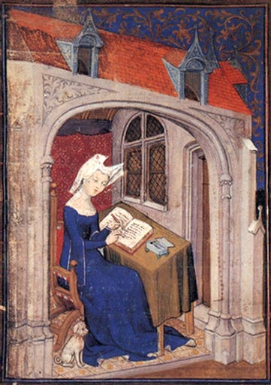
The Role of Women
Traditional roles: wife and childcare provider, patriarchal
Code of Chivalry: reinforced ideas that women were weak and subordinate
Nun: alternative to marriage
Two attitudes:
  Veneration of Mary and female saints give women cultural and religious prestige
  Emphasis on Eve as source of sin
No property rights but could trade and belong to some craft guilds
Growing literature discussing women’s roles as comforters to men, list docile virtues

Slide 64
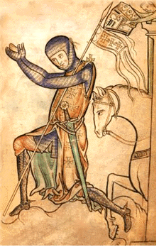
The Decline of the Medieval World
After 1300: overpopulation, severe famine; warfare, and disease
1348: Bubonic Plague (Black Death)
  Kills ½ - 2/3 European population
  Started in China; travels along Silk Road
Knights lose military purpose; become decorative
  Foot soldiers more important and practical
  Growth of professional armies; shook authority of feudal lords who used to supply armies
  New weaponry (cannons, gunpowder); traditional methods (fortified castles) irrelevant
    Example: Hundred Years War (1337-1453)
  Aristocracy do not disappear; choose to live in rich ceremonial style that exhibits court life and chivalry

Slide 65
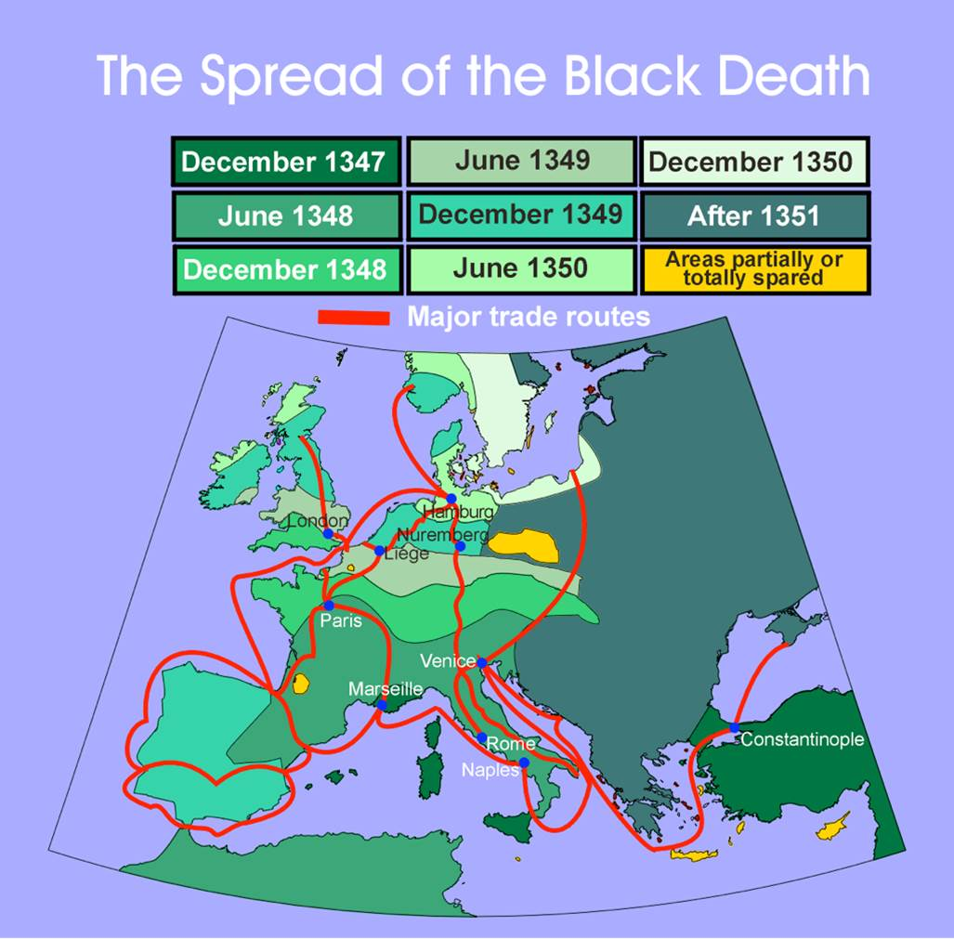

Slide 66
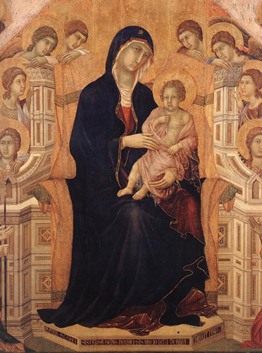
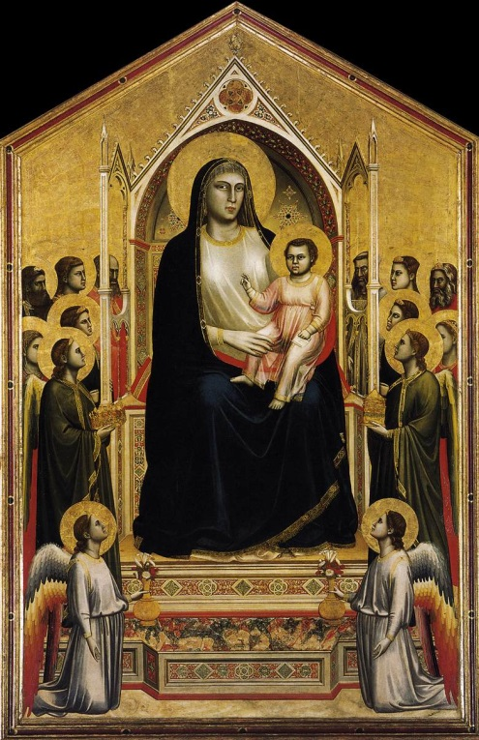
Changing Culture
Church increasingly rigid
  Series of controversies over papal authority distance Church from everyday devotion (rival claimants to papacy)
  Reformers and mystics emerge (no longer need Church to have direct experience with God)
Proto-Renaissance: Intellectual and artistic life develop
  Art: realistic portrayals of space and nature, growing interest in the body

Slide 67
The Postclassical West and Its Heritage
“Middle Ages” implies lull between glory of Rome and glitter of Renaissance
Formative period
  Backwardness and vulnerability
  Dynamic change (trade, intellectual activity, Gothic)
Marked change in relationship between West and regions around it (Crusades and trade)
  Europe originally at mercy of invasions (Vikings, nomadic groups from central Asia)
Nervous about power of Islam (false religion, deep threat to Christians and Holy Land)
  Yet, actively copy Islam (law, science, art)

Slide 68
Let’s Practice
  Following the fall of Rome, where was the center of the postclassical West?
    In the former Roman colony of Spain
    In Italy, particularly Rome
    In the central plain of northern Europe
    Greece
    Constantinople

Slide 69
Let’s Practice
  Following the fall of Rome, where was the center of the postclassical West?
    In the former Roman colony of Spain
    In Italy, particularly Rome
    In the central plain of northern Europe
    Greece
    Constantinople

Slide 70
Let’s Practice
  What monk was responsible for the creation of a set of rules for Western monasteries in the 6th century?
    Basil
    Bernard of Clairvaux
    Benedict of Nursia
    Boniface VIII
    Cyril

Slide 71
Let’s Practice
  What monk was responsible for the creation of a set of rules for Western monasteries in the 6th century?
    Basil
    Bernard of Clairvaux
    Benedict of Nursia
    Boniface VIII
    Cyril

