Slide 1
“Building an Argument Tower”
Before we begin: Get into groups of 2 or 3 and pick up supplies
What you’ll need:
Six colored 3×5 cards, 2 of each color.
A pair of scissors.
Three highlighters in colors that match the colors of the cards.
Analyze the similarities and differences between Egypt and Mesopotamia’s development.

Slide 2
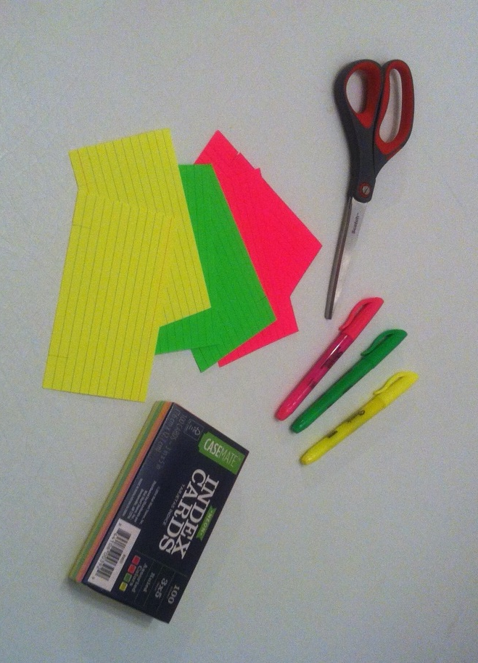
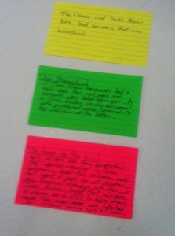
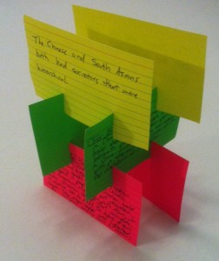
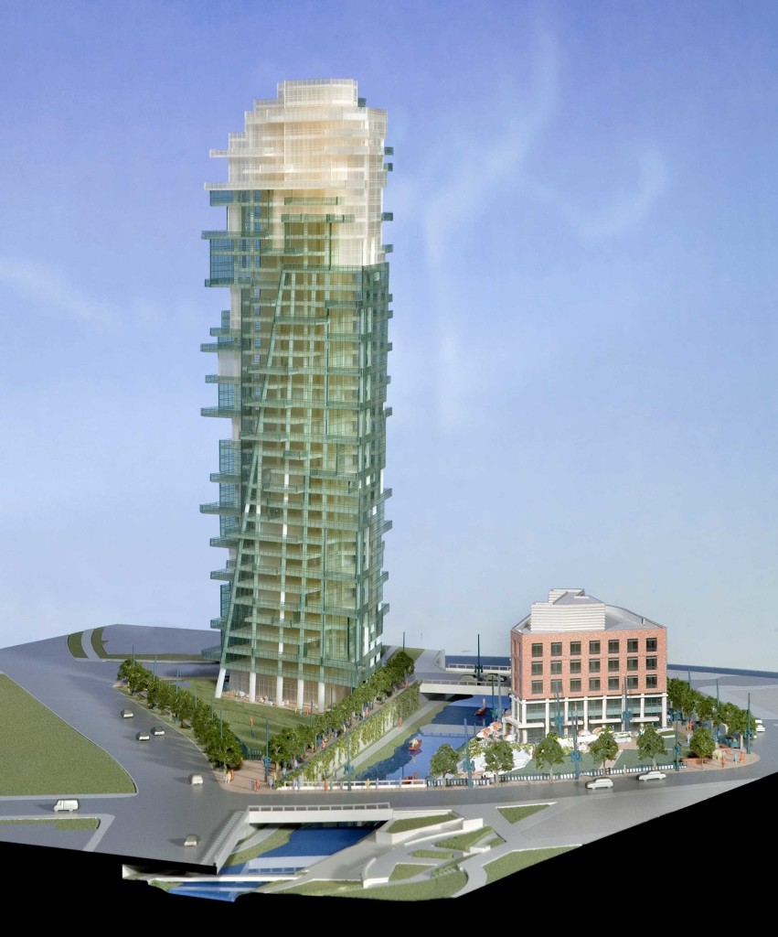
Argument Towers
Directions: In your groups discuss the research question in their group.
Make an assertion
Brainstorm historical evidence for your assertion
Analyze your assertion.
Using the cards, you will physically build an Argument Tower to support your assertion.

Slide 3
Argument Tower Steps
Step 1 – on your white index card, write your thesis statement. You will have at least 3 arguments (assertions) which will stem from this thesis statement.
Step 2) At the top of one of their green 3×5 cards, someone writes the words “For example, ” At the top of the red/pink card, someone writes “The reason for this is . . . ” Note: This is one of your 3 main arguments/groupings based on the prompt.
Step 3) Students develop an (ONE) assertion that states a political, economic, or social cause of the fall of the Roman and Han Empires. They write this assertion on the yellow card as shown to the right.
Step 3) Next, students in each group must come up with concrete historical evidence to illustrate this assertion. These need to be content-specific vocabulary words. The group then composes the evidence portion of their tower to support the assertion. Cause and Effect: summarize the cause and effect of the political, economic or social fall of the two Empires.
Step 4) Now students will analyze their assertion. This moves away from the WHAT and begins to explain the WHY. In short, students must make an argument from history about why your assertion caused the downfall of these two Empires. This goes on the last card after the words “The reason for this is . . .” “Due to this…”
Step 5) Now that students have made their assertion, evidence and analysis cards, they are ready to build their Argument Tower. The assertion must be supported by the other two components.
Step 2
Step 3
Step 4

Slide 4
“Putting it Together”
The Argument Tower becomes an important part of the essay providing supporting evidence and analysis. Students can make another argument on the backs of these cards.

Slide 5
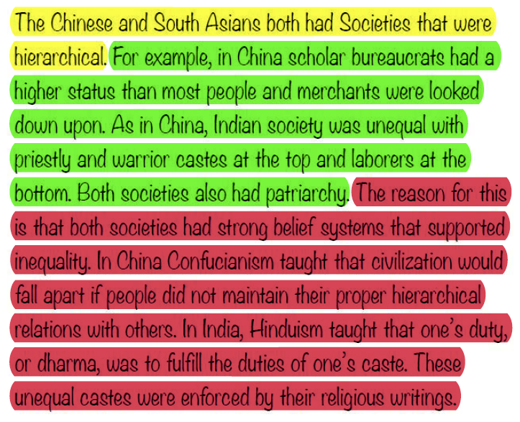
“Putting it Together”
Each essay should have a few argument towers. The colors help students understand that the assertions, evidence, and analysis are discrete components of an quality essay. You will practice highlighting your essay

Slide 6
“Building an Argument Tower”
Before we begin: Get into groups of 2 or 3 and pick up supplies
What you’ll need:
Six colored 3×5 cards, 2 of each color.
A pair of scissors.
Three highlighters in colors that match the colors of the cards.
Analyze the similarities and differences between Egypt and Mesopotamia’s development.

