Slide 1
Scope of Congressional Powers & the Expressed Powers of Congress
11.1 & 11.2

Slide 2
Congressional Power
Powers of the government are limited and the American system of government is federal
Power is delegated in the Constitution

Slide 3
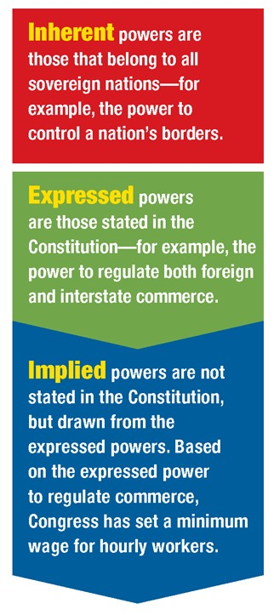
DELEGATED POWERS
There are three types of powers granted by the Constitution.
Article I gives 27 specific powers to Congress.
The Constitution also denies many powers to Congress, banning some and reserving others to the states.

Slide 4
What Congress Can and Can’t Do
They Can… | They Can’t…
Any expressed power | Create a national public school
Implied Power | Require voting
Inherent Power | Require church attendance
 | Create a minimum age for marriage or drivers license
 | Abolish jury trials
 | Confiscate hand guns
 | Censor news

Slide 5
Strict vs. Liberal Construction of the Constitution
Much of the federalist vs. anti-federalist debate at Constitutional Convention was about the Powers of Congress
Strict Constructionist | Liberal Constructionist
Jefferson & Anti-federalist | Hamilton & Federalist
Congress should ONLY used their expressed powers – implied powers that were necessary to carry out expressed powers. | Liberal interpretation of the Constitution and allow Congress to have broad powers.
Wanted to protect interstate trade & provide for a national defense | “Energetic government”
States should have as much power as possible “That government is best that governs least” | This is what has allowed for the growth of the national government
Argued states are not the same and national government couldn’t preserve differing interests – only states could

Slide 6
EXPRESSED POWERS
18 clauses and 27 powers.
In the Federalist Papers, James Madison answered this question by grouping the enumerated powers into five categories.
5 groups are:
Security against foreign danger
regulation of the intercourse with foreign nations
maintenance of harmony and proper intercourse with the states
miscellaneous objects of general utility
provisions for giving due efficacy to all these powers.

Slide 7
Expressed Powers
Security against foreign danger: | Regulation of the intercourse with foreign nations:
Clause 1: levy taxes, duties, and excises | Clause 1: regulate foreign commerce
Clause 2: borrow money | Clause 10: define and punish crimes committed on the high seas and offenses against the law of nations
Clause 11: declare war
Clause 12, 13, 14: raise regulate, and provide for armies and navies
Clause 15 and 16: organize, arm, discipline, and call forth the militia to execute federal laws, suppress uprisings, and repel invasions

Slide 8
EXPRESSED POWERS, CONT.
Maintenance of harmony and proper intercourse with the States:
Clause 3: regulate commerce among the several States and the Indian tribes
Clause 4: establish a uniform rule of naturalization and uniform laws of bankruptcy
Clause 5: coin money, regulate the value of domestic and foreign coin, fix the standard of weights and measures
Clause 6: provide for the punishment of counterfeiting
Clause 7: establish post offices and and post roads

Slide 9
Expressed Powers Continued
Miscellaneous objects of general utility: | Provisions for giving due efficacy to all these powers:
Clause 8: establish patent and copyright laws | Clause 18: The Necessary and Proper Clause
Clause 17: legislate for the seat of the federal capital and other federal territories

Slide 10
Powers of Congress Continued
Most powers are very brief and meaning of the actual clause is found by Congress exercising powers and Supreme Court cases stemming from Congress’ actions.
For example the Commerce Clause:
“To regulate Commerce with foreign Nations, and among the several States, and with the Indian Tribes” –A1,S8,C3

Slide 11
What powers over money and commerce does the Constitution give to Congress and what limits does it put on these powers?
The commerce power gives Congress the authority to regulate interstate and foreign trade, but not trade within a state.
Congress has the power to tax income and imported goods, but not exports.
Congress can set bankruptcy laws.
Congress can coin and print money.

Slide 12
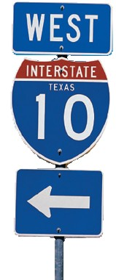
THE COMMERCE CLAUSE
The weak Congress created under the Articles of Confederation had no power to regulate interstate trade and little authority over foreign commerce.
The 1780s were marked by intense commercial rivalries among the States. High trade barriers and spiteful State laws created chaos and confusion in much of the country.
The circumstances led the Framers to write the Commerce Clause into the Constitution.

Slide 13
THE COMMERCE POWER
The federal government gains great power from the broad interpretation of the commerce power.
However, there are limits to the commerce power.
Congress cannot tax exports, favor the ports of one state over another, or require vessels to pay duties when traveling from one state to another.
The commerce power is even used to ban discrimination in public businesses.

Slide 14
AMERICANS WITH DISABILITIES ACT
Based on the commerce power, Congress passed the Americans with Disabilities Act in 1990. It prohibits against discrimination against people with disabilities in areas such as employment, public accommodation, public transportation, and access to commercial buildings.

Slide 15
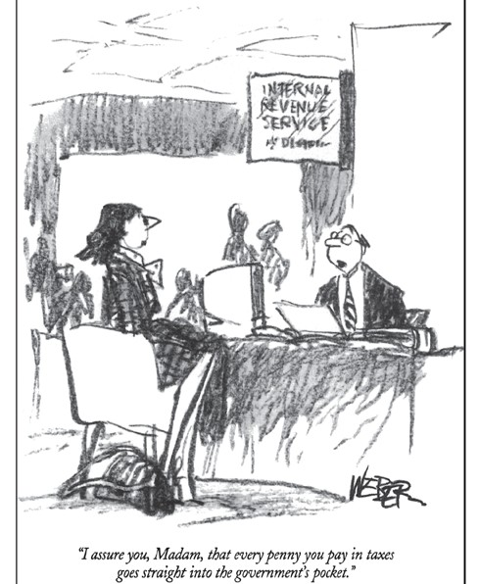
THE POWER TO TAX – A1,S8,C1
Most government taxes on people or property are levied to raise money for public needs.
95% of government money comes from taxes.
A tax is a charge levied by the government on persons or property to raise money to meet public needs. (Sometimes other purposes)

Slide 16
TAXATION
A protective tariff taxes imports to protect domestic industries from foreign competition by increasing the cost of foreign goods.
Some taxes, often in the form of licenses, are meant to protect public health and safety. Example: regulation of narcotics
Name three purpose for which the government collects taxes.

Slide 17
LIMITS ON TAXATION
Congress can tax only for public needs, not for the benefit of private businesses or individuals.
4 Limits on Taxing:
Congress cannot tax exports
Direct taxes, except for income taxes, must be divided among the statesin proportion to their populations.
All indirect taxes levied by the federal government must be unifrom, or the same, across the United States.
An indirect tax is one in which one person pays the tax but then passes along the cost of the tax to others. This is done by charging them higher prices for the good or service that is taxed.

